Slide 1
Full Stack
Observability
Platform for
Site Reliability
as a Service
What, Why and How?
April 2023

Slide 2
full stack observability for a digital first enterprise
Business
Impact
End User
Experience
Application
Performance
Infrastructure Optimization
I want to assess the impact of application performance on revenue generation.
What was the revenue during the last campaign or what was the segment of users who were unable to engage with the business due to outages?
I want to monitor the user experience with application performance metrics.
Understanding user behavior while consuming the digital services is critical to assess where to invest to improve the digital services.
I want to quickly spot anomalies in the application performance
The speed with which one can identify root cause of problems will be the line between a successful digital business or a failing business. APM tools are used for this purpose.
I want to optimize infra costs without sacrificing the application performance
An application centric approach to infrastructure optimization ensures availability of right level of resources as the application needs per different traffic conditions.
Network Performance
Security Threat
Canary Deployments
Full Stack Observability
I want to eliminate network as the cause for application performance issues.
Continuous security threat identification and blocking detecting application dependencies and configuration vulnerabilities is critical.
I want to do a limited release of new code to a limited set of users to quickly determine stability and either do a full release or do an easy roll back.
I do not want to use ten or more tools and still get discrete uncorrelated data from multiple domains that delays the rapid analysis of the root cause of problems.

Slide 3
what is full stack observability?
Observability enables quick interrogation of a digital service about performance degradation
Full Stack Observability (FSO) inherently looks at the Full Stack of available data
From infrastructure to applications, digital experience, business KPIs and social sentiment
The relationships and dependencies among these elements
FSO is predicated on MELT data generated by the superset of Continual Testing and Monitoring
Metrics to establish the behavior of the system over time
Event Logs to enable fine grained debugging and predict behavior of complex distributed systems
Traces that show flow of a request through a distributed system
Analysis
Net
Social
Business context
CX
ITSM
Changes
Traces
Events, Logs
Metrics
API

Slide 4
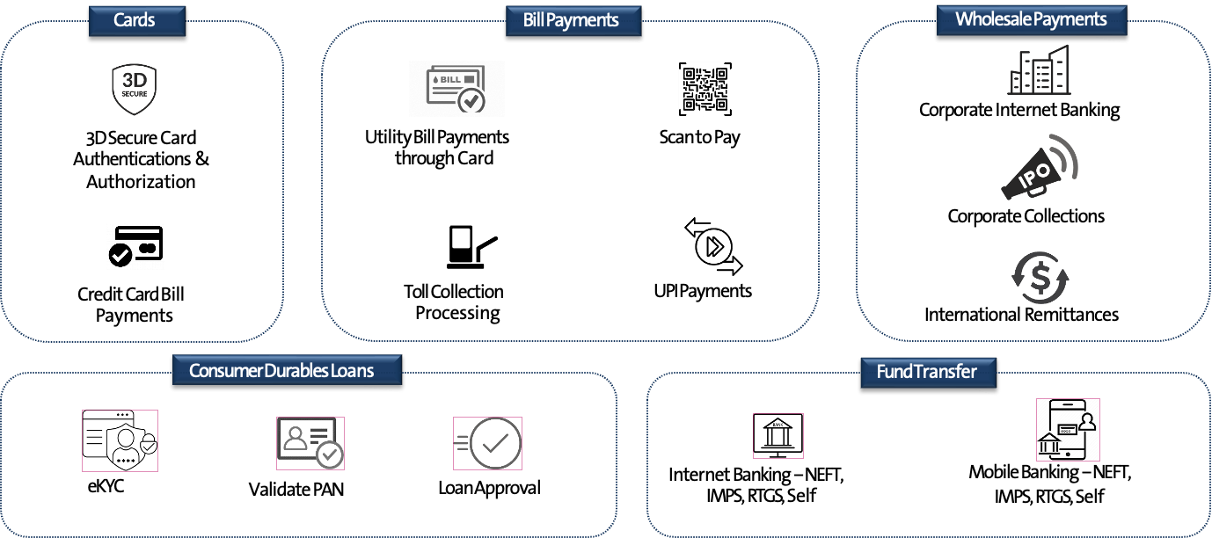
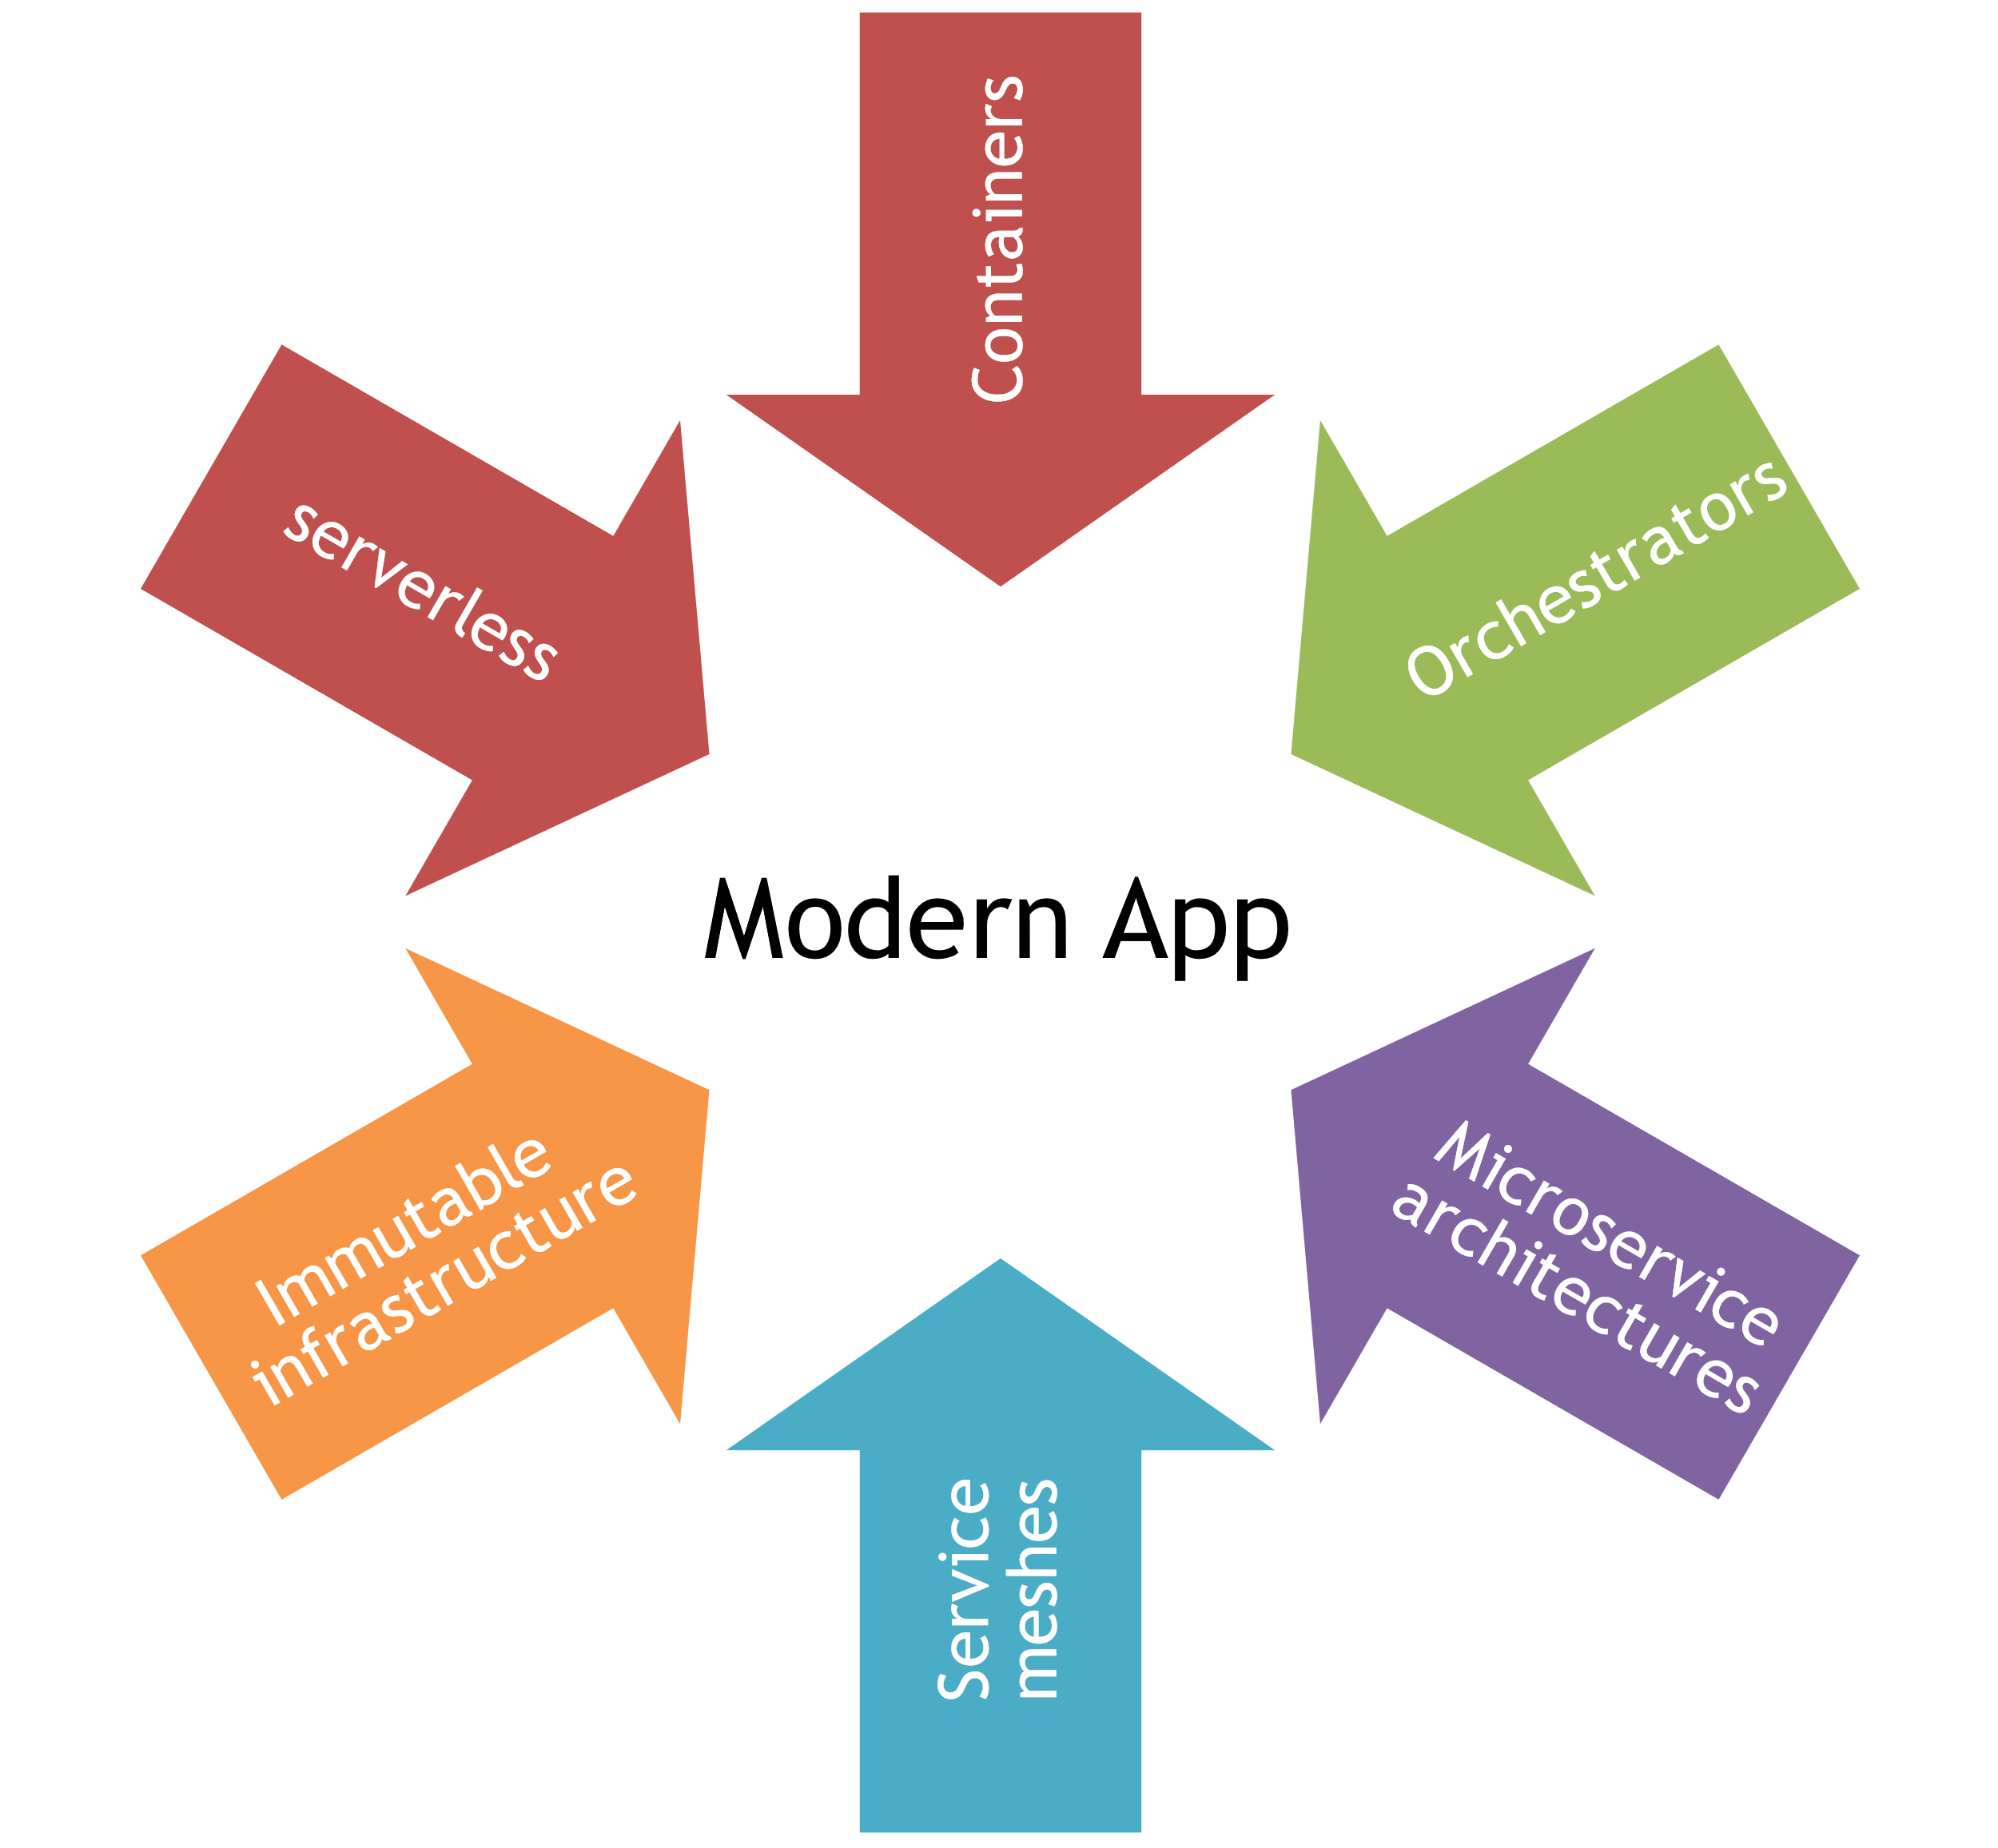
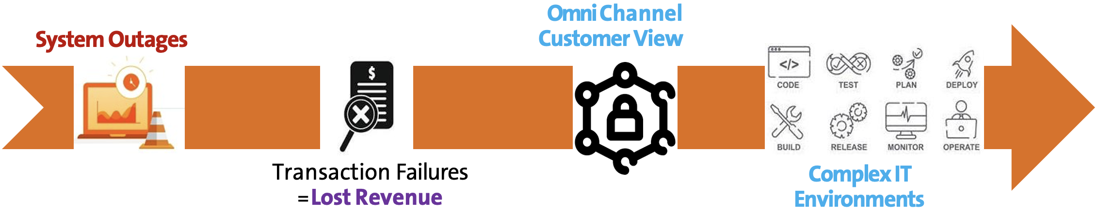
Why do we need end to end business Journey Visibility?
With distributed systems and modern apps, it is no longer about how the code runs but where in the system is the code with the problem!
Faults emerge from complex interactions between applications and environments

Slide 5




Business journey observability outcomes
Real-time Transaction
Performance Visibility
Transaction volumetrics including Tech Declines / Business Declines, TAT
Micro-transaction view based on Protocol
Dimensional
Analysis
360-degree view of performance by Issuer/Acquirer, Aggregator) eco-system entities
(E.g., Merchant, Issuer / Acquirer, Aggregator)
Segmentation by lead indicators (E.g., TAT, TD/BD)
Static and dynamic baseline driven notifications on any lead indicator (E.g., TPS increase, Dip in Success Rates, Spike in Volumes from a PSP)
Anomalous behavior driven notifications (E.g., Unexpected dip in Volumes)
Configure rules to identify suspicious behavior of transactions
Notifications
Transaction
Intelligence
Extract customer, transaction and entity information from payload and protocol etc.
to enrich downstream business applications
Long-term data analysis for compliance and reporting

Slide 6
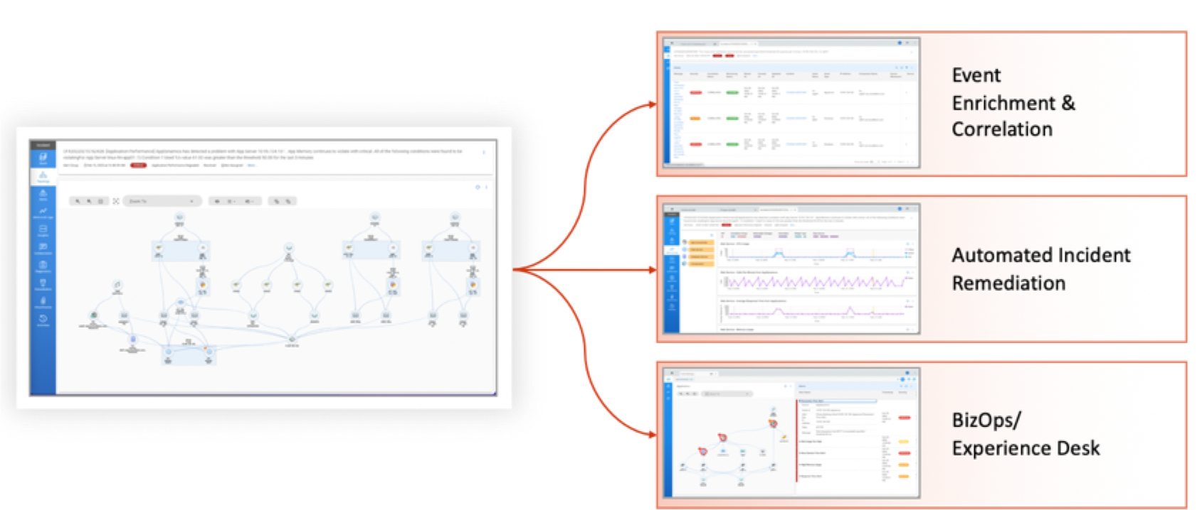
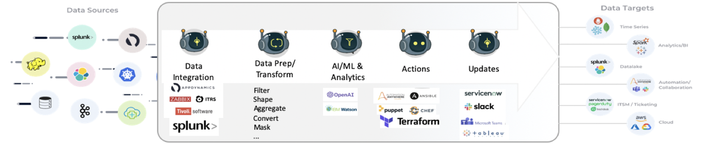
How to accomplish FULL STACK OBSERVABILITY?
FULL STACK SERVICE MAP
Reduce TCO by 50%
MODERN ROBOTIC DATA AUTOMATION PLATFORM Reduce Time to Value by 70%

Slide 7

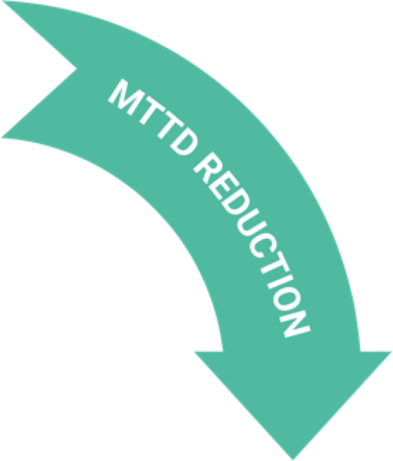

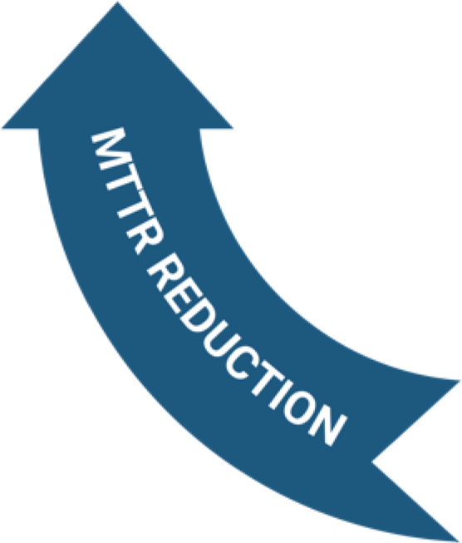

The SIFY digital full stack observability framework
Proactive Assurance
Event Correlation / Noise Reduction
Continuous assurance of outcomes
*Business Level Service Assurance &
Dashboards-
Predictive analytics and insights
Multi-source Integration: Cloud, Edge, DC
Pull Events, Metrics, Logs & Traces
Enrich with Full stack context
Apply ML & Algorithmic Correlations
FSO
Framework
Faster Incident Resolution
Faster Root Cause Analysis
2-way collaboration capabilities
Built-in Diagnostics
*Auto-remediate with workflow automation
Topology based root cause analysis & Forensics
Single pane of Observability with on demand ops triage dashboard – Metrics, logs, KPIs, tickets, outcomes

Slide 8


Observability and site reliability engineering
SRE focuses on the reliability and availability of software systems by building on DevOps to automate system configurations, monitoring and maintenance.
Observability monitors and measures the internal state and external interactions to identify and diagnose issues that may affect performance and availability.

Slide 9
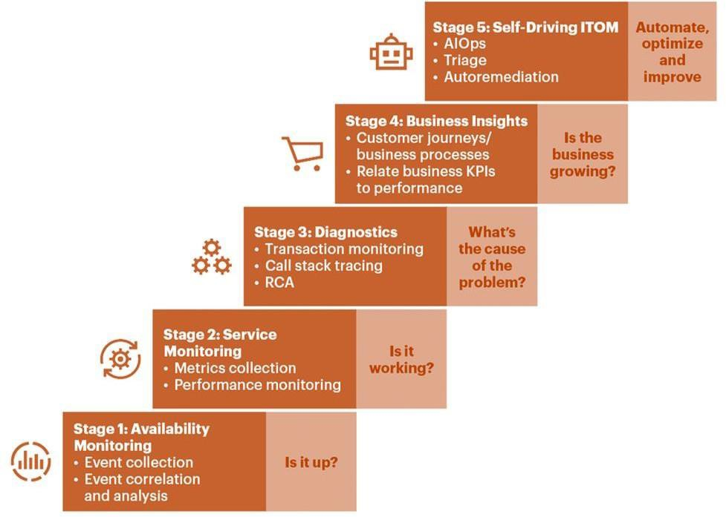

Maturity model for enhancing the site reliability
Auto Remediation
PREDICTIVE
ML Driven Operations
PROACTIVE
Journey Visibility through Data lake
ADAPTIVE
Unified Visibility
REACTIVE
Cross domain
full stack data pipeline
Source: Gartner

Slide 10
Sify digital services for fso and sre
Monitor and remediate performance of traditional and hybrid applications
Monitor performance of microservices-based cloud native applications
Gain actionable insights into the application experience and its underlying dependencies and business impact
Organizations want to:
Determine the root cause of issues affecting performance and customer experience faster and more efficiently
Map app dependencies properly, measure performance and set metrics and KPIs
Prioritize better which problems to tackle first, without relying solely on past experience and gut feeling
But are challenged by:
Lack of visibility into architectures distributed across hybrid cloud
Limited visibility into external environments that shape the application experience
Little to no visibility into how app performance impacts business critical KPIs and revenue streams
Value add by Sify Digital Services
Perform environment discovery exercise on application and infra
Define success criteria for performance issues resolution (SLO)
Northbound API integration to ServiceNow / other ITSM tools / Business KPI dashboards

Slide 11
additional services for site reliability engineering
Full Stack Observability as a service
Help instrument the code with OpenTelemetry
QA to identify and troubleshoot issues and file detailed bug reports
Testing in Production
Testing through Deploy, Release and Post-release
CI/CD automation, Canarying, Traffic Shaping, Exception Tracking, Chaos Testing, Monitoring, Logs / event tracking
Trace-Based-Testing to create assertions to validate end-to-end system flow
Tracetest, Malabi, Helios
Help define Service Level Objectives
Help implement codify SLOs with OpenSLO
Policy as Code
Help implement Open Policy Agent (OPA) / Kyverno for Kubernetes …
Common Services
K8S cluster admin and maintenance, GitOps flows, Infrastructure as Code, Self Service Provisioning, SLO triggered workflows

Slide 12

Thank You

