Slide 1
SIFY TECHNOLOGIES INDIA’s DIGITAL INFRASTRUCTURE LEADER
Building the platform for India’s Digital Future
April 2023
Enabling Cloud and Digital Services | Hyperscale Data Center Campuses | Next Gen Enterprise Network Services | Hyper-Scale Network Infra
Notes:
This slide must be applicable to both Network and DC – Change cover photos and generalize Sify description (initial edits below)
Relevant network content has to be added

Slide 2




SIFY NETWORK SERVICES IN A NUTSHELL
Global Interconnects:
London, Marseille, New York, Los Angeles, Singapore, Hong Kong, Dubai
Local Interconnects:
7 locations in India
India’s most expansive network 1600+ cities with >3600 POPs
Full mesh nX 100G backbone with diverse infra protection
Multiple access media options:
Fiber, Fixed Wireless, Offnet
Infrastructure and Services
Ethernet Services
Business Internet Services
IPVPN Services
Cloud Connect Services
MEF E-line compliant & VLAN-based EVPL Services across India
Transport to Asia, Europe, Middle East
In-country Peering with all content providers/telcos
IPT to Asia, Europe and North America @ 500 G+
Performance SLAs with peering in Europe, North America, Asia
QOS and CSC support for easy integration and service extension
Local interconnect w/ all telcos for diverse access
High-availability services to AWS, Azure, Google, Oracle
Resilient interconnects in Chennai, Mumbai, Delhi, Bengaluru and Hyderabad
Notes:
Network Product 1 (Hyper-reach WAN) -- details and facts
DN : Still a bit text-heavy; edit down if possible. Some suggestions below.

Slide 3










KEY HIGHLIGHTS
Bespoke Network designs for >99.99% hyperscale resiliency
Wide Area Networks spanning 1600 + cities
Datacenter interconnect services across 52+ DCs
Cloud Integrated Network for On-Ramp Connectivity
Sify OnNet: SDN networks in over 350 buildings
Over 16,000 km of diverse metro fiber in 10 major cities
ENTERPRISE / WHOLESALE SERVICES
HYPERSCALE NETWORK SOLUTIONS
Submarine capacities to Europe, Middle East, and Asia
National Long-Distance nX100G network across Top 7 cities
Submarine capacity backhaul services
Open Submarine landing stations in Mumbai and Chennai
Notes:
NOTES TO ANOOP
Added 99.99% on hyperscale resilience, should be higher?
Re Submarine backhaul, should we add anything about our capability to do the breakout services under our license?
Deleted the cost-sharing model for NLD, since I added this to previous slide

Slide 4


SIFY NETWORK STRATEGY
WIRELESS NETWORK INFRASTRUCTURE
METRO NETWORK INFRASTRUCTURE
3600+ Base stations connected in India
1600+ towns covered across pan India
SDN powered enterprise networks
75+ Microwave Base station implemented to obtain low latency and high uptime
Automation tool enabled for network expansion
Hyperscale-ready metro network in 10 cities; Metro access networks in 50+ cities
New Metro Network WIP in 7 cities and 5 cities planned in FY 23-24
350+ building connected in Metro network & 52+ Connected Data Centers
Over 16,000 km of diverse metro fiber in 10 major cities
100 G metro networks deployed in India
Notes:
PP has completed the DC Infra
Anoop to check NW Infra

Slide 5

Sify’s Hyper reach wireless network
Geographic Reach
Services
1600+ cities and towns
3600 base stations
MPLS Over VPN and DIA
Highly relevant to distributed enterprises
Backhaul Scalability
Technology Upgrade
Conversion of base station backhaul to fiber in Tier 1 and Tier 2 Cities
Microwave additions across Tier 2 and Tier 3 sites requiring high bandwidth
Wifi – 6E and 5G trials commencing

Slide 6
METRO NETWORKS – 22 City coverage
Tier 1
Tier 2
Tier 2
Nx400G /Nx100G
7 Cities Rolled Out
3 Cities Rolled Out
Nx10G
7 Cities – WIP; live in Q1/Q2 of FY 23-24
Nx10G
Tier 2
5 Cities – Planned in FY 23-24
Nx10G
52 DC’s and Cloud Providers
Delhi
Jaipur
Ahmedabad
Kolkata
Mumbai
Pune
Hyderabad
Bangalore
Chennai
Cochin
350+ Buildings Connected

Slide 7
METRO NETWORK CITIES
OPERATIONAL
WORK IN PROGRESS
PLANNED
(Operational FY 23-24 (Q1/Q2)
FY 23-24 (Q2)
Chennai
Mumbai
Delhi
Kolkata
Bangalore
Hyderabad
Pune
Ahmedabad
Jaipur
Cochin
Coimbatore
Nagpur
Bhubaneshwar
Chandigarh
Indore
Patna
Lucknow
Kanpur
Guwahati
Bhopal
Trivandrum
Vizag

Slide 8

METRO SPREAD REGION AND CITY WISE - SOUTH
Hyderabad
  4 Data center
  6 Core POP
  47 Collector POP’s
  1600+ Kms of fiber
Bangalore
  12 Data Center
  6 Core POP
  73 Collector POP’s
  2000+ Kms of fiber
Vizag
Planned FY 23-24(Q2)
Cochin
  1 Data Center
  2 Core POP
  34 Collector POP’s
  400+ Kms of fiber
Chennai
  7 Data Center
  7 Core POP
  51 Collector POP’s
  1800+ Kms of fiber
Trivandrum
Planned FY 23-24(Q2)
Coimbatore
  Operational FY 23-23(Q1)

Slide 9
METRO SPREAD REGION AND CITY WISE - WEST
Ahmedabad
  1 Data Center
  3 Core POP
  15 Collector POP’s
  600+ Kms of fiber
Mumbai
  14 Data Center
  13 Core POP
  89 Collector POP’s
  3900+ Kms of fiber
Indore
Planned FY 23-24(Q2)
Pune
  3 Data Center
  5 Core POP
  59 Collector POP’s
  1850+ Kms of fiber
Bhopal
Planned FY 23-24(Q2)
Nagpur
  Operational FY 23-23(Q1)

Slide 10
METRO SPREAD REGION AND CITY WISE – NORTH
Chandigarh
  Operational FY 23-23(Q1)
Delhi
  7 Data Center
  7 Core POP
  83 Collector POP’s
  2000+ Kms of fiber
Jaipur
  1 Data Center
  1 Core POP
  25 Collector POP’s
  750+ Kms of fiber

Slide 11
METRO SPREAD REGION AND CITY WISE – EAST
Kanpur
Planned FY 23-24(Q2)
Guwahati
Planned FY 23-24(Q2)
Kolkata
  2 Data Center
  6 Core POP
  46 Collector POP’s
  1300+ Kms of fiber
Lucknow
Planned FY 23-24(Q2)
Patna
Planned FY 23-24(Q2)
Bhubaneshwar
  Operational FY 23-23(Q1)

Slide 12
Sify National 100G Backbone NETWORK
DEL
Sify NLD backbone is a combination of wavelengths from multiple providers for maintaining carrier and path level redundancies.
Every Tier 1 PoP features connections with capability of 100G between core backbones. POP level redundancies are maintained in all the regions
All services are protected at path level & provider level with high SLA
KOL
MUM
CHE
HYD
PUN
BGL

Slide 13
SIFY’S Global presence
Europe
London
France Marseille
Dubai
Bangladesh
Border IC
USA
NY
USA
LA
India
HK
Singapore
Presence in 7 countries
Partnering with enterprises telcos in each of these markets
Rapidly scaling global network – nx10G to nx100G
Focus on interconnection into SAARC countries

Slide 14
NEW INITATIVES - National Express Route and Open CLS
NATIONAL LONG-DISTANCE NETWORK CONNECTING 7 MAJOR CITIES IN INDIA
3 path protection across most city pairs
Express–routes primarily over OPGW infra
Mumbai Pune Live July ‘22
Mumbai
Delhi
RFS April ‘24
Mumbai Hyderabad
RFS Dec ‘23
Hyderabad Chennai
RFS June ‘24
Designed for optimal DC to DC application (vs network aggregation)
OPEN CABLE LANDING STATIONS
Versova, Mumbai CLS (operational >10 years)
Siruseri, Chennai CLS (RFS Q4 2023)
Open CLS as Managed Infrastructure Service
GBI / MENA
Blue Raman
RFS Q4 2023
Expansion room for 2 more Cables
DCI adjacency to all major DCs in Mumbai
Designed to land 4 new age cable systems
Direct landing in Chennai 02 (6 km fiber distance)
Distributed Architecture with Scalable SLTE Hosting
Diverse routes bypass road ducts from Landfall to SLTE

Slide 15
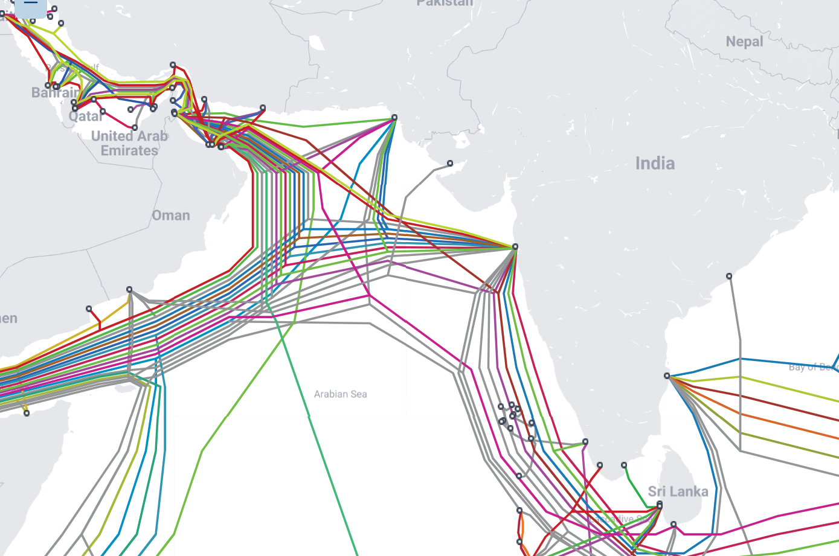
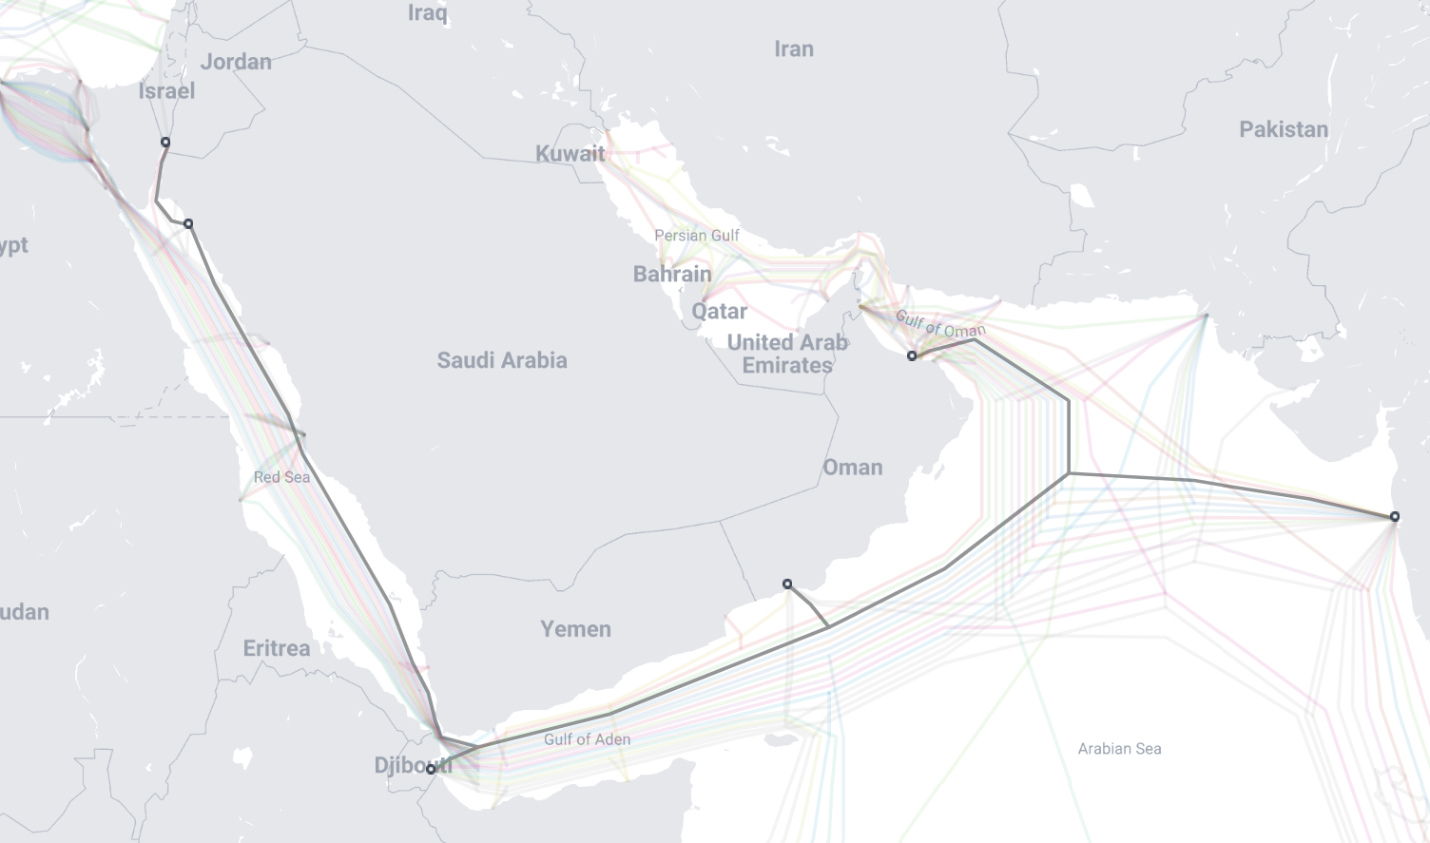
MUMBAI Cable landing station
Mumbai Versova Cable Landing Station
Expansion of the Versova CLS with additional capacity
Blue Raman system – RFS 2024 - 300 Tbps
First Egypt bypass system from India, reaches Europe without going through the Suez Canal
GBI – 2012
MENA – 2014
Raman – 2024 RFS – 15 Fiber Pairs X 200 Tbps capacity
Notes:
WIP
CLS story coming from Harsha/ Ajay

Slide 16

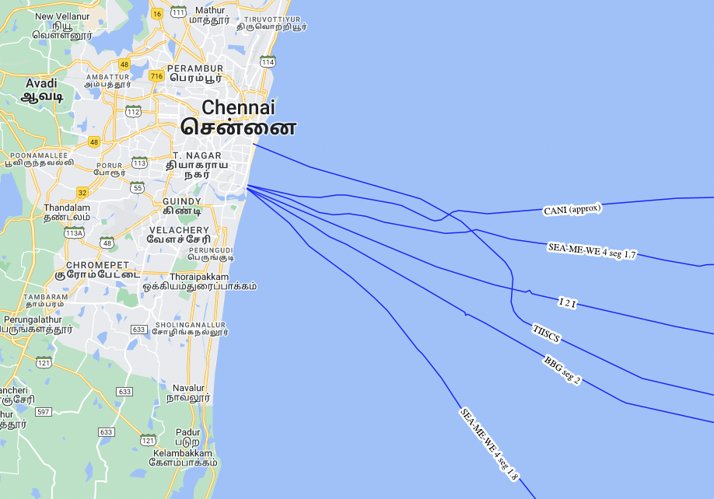
Chennai 02 Data Center Campus with Integrated CLS (SIRUSERI)
Other CLS
H11/A, Sipcot IT Park, Siruseri, Tamil Nādu, 603 103.
Hyperscale DC campus designed for
78 MW IT capacity
Dedicated on-site
220 KV GIS substation
All Towers interconnected incl. Bulk Fiber
Four fiber entry paths;
Multiple telcos
Integrated Cable Landing Station for Transpacific fiber access
Sify CLS
CLS is away from port, fishing zones, oil blocks and all existing subsea cables
Built on stilt structure, all equipment to be on Level 2 and 3
Initial power is 700 KW; to be ramped per requirement
800-1000 Tbps capacity
Notes:
WIP
CLS story coming from Harsha/ Ajay

Slide 17










Data center Interconnect and Sify ONNet (SDN)
DATA CENTER INTERCONNECT
SIFY ONNET
High-performance network fabric connecting all major Data Centers, Cloud Onramps, CLS, NLD transit points
Sify OnNet:
India’s first Automated Enterprise WAN
Highly diverse, hyper-scale infrastructure (400G waves)
Bandwidth on Demand Pay as you go
India’s only DCI services suite with 99.99% guaranteed availability
Deployed in 10 cities, 350+ Buildings, 52+ DCs
Designed for optimal DC to DC applications
Ethernet, Business Internet, Cloud Connect Services
Key Service Features:
3 path protection
1G/10G/100G native interface
ROADM architecture w/ sub-50ms convergence
Expansion plans for 500+ buildings in the current year
Notes:
Network Product 2 (DC Interconnect) -- details and facts (includes SDN?)
DN : Still a bit text-heavy; edit down if possible. Some suggestions below.

Slide 18

Sify network customers

Slide 19
Sify Managed
Network Services

Slide 20
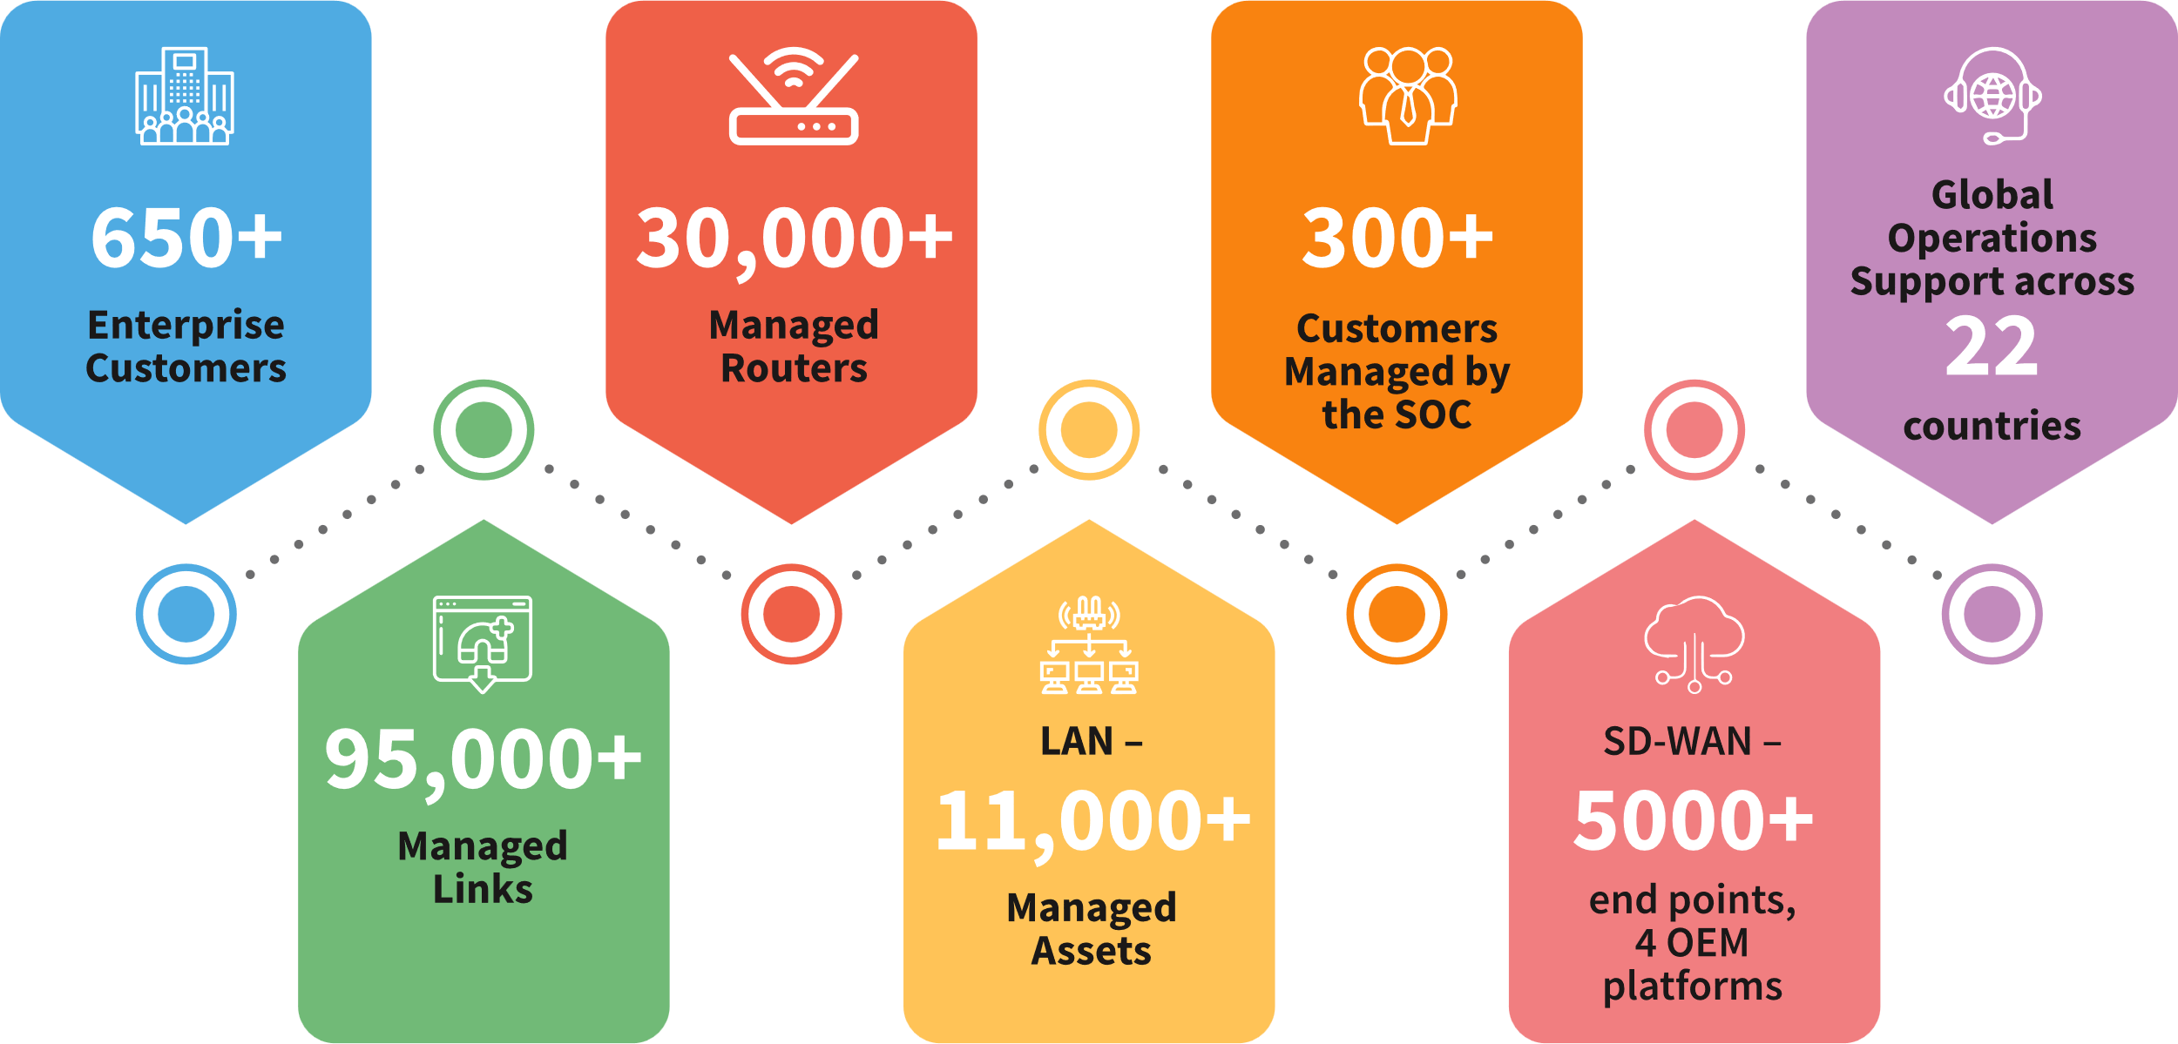
MANAGED NETWORK SERVICES
Large Project Experience
Extensive Skillsets
Advanced Network Tools & Integration
Constant Innovation
Technology Partnerships
Customers prefer Sify for its expertise in end-to-end managed solutions, deep engagement with OEMs, Network-agnostic managed services, quick & cost-effective rollouts, project implementation expertise and extensive operations support across 1500+ cities

Slide 21
MANAGED SD-WAN
Sify delivers a managed SD-WAN (Software-Defined Wide Area Network) platform that is built in partnership with leading OEMs. We provide the services to 50+ customers with 6000+ nodes
Networking and security converged
Faster transition to secure access service edge (SASE) architecture.
Optimized for multi-cloud
Infrastructure to deliver Cloud connectivity to SaaS, PaaS and Hybrid clouds
Cloud-scale infrastructure
Multi-tenant, cloud-native platform to orchestrate, provision, control and manage tenants
Enhanced visibility
CPE health, Availability report, Link statistics, App performance – based routing
Transition to cloud-centric infrastructure
Cost optimization by integrating multiple transports
End-to-end managed SD-WAN integrated with SASE
Transport independent fabric providing a secure scalable NG overlay
Sify SD-WAN is present across all the major industry verticals such as BFSI, Manufacturing, Retail etc.

Slide 22


Sify SD-WAN offering
ONE
MANAGEMENT
24/7 Managed services focused around outcomes
Watch
Incident
Problem
Project
Field
Analytics
ONE
POLICY
Unified security policy across the network & locations
Sify Cloud
NG Firewall
Content filtering
Intrusion prevention
PKI
ONE
NETWORK
SLA backed network services connecting users to DC/Cloud
Intelligent Routing
Network Reliability
Network Optimization
Encryption
Sify MPLS/ BYOP
Sify MPLS/ Internet/BYOP
Sify MPLS/Internet
Sify CloudConnect
CE
CE
CE
CE
CE
Branch
Corporate/HO
Factory
Cloud
Datacenter

Slide 23
SASE: Bundled Security for Cloud, Data, Applications
Creating Bundled Services
Network Intelligence Tool = Visibility
SASE platform = Control
Clean Internet
  Network based service, not focused on end-user
  Customers can also be a downstream ISP
Integrate with SD-WAN
  Inbound sec with SD-WAN
  outbound sec with SASE platform
Remote connect (WFH) for MPLS customers
  Secure Site Connect - network based
  Secure Roam Connect - end-user based
Bundle with Wi-Fi as a Service
  Next gen secure network as a service
Network Performance [NOC]
Security
Digital Experience
SD-WAN
WiFi
SASE
Network Intelligence
Users, End-Points, Transport, Network Hardware

Slide 24



Network Management and Operations scope
Network Operations Outsourcing
Network Consolidation & Operations Outsourcing
Network Transformation
& Operations
Operations Transition from existing managed services provider to Sify
Advanced NOC Services
SLA Management
Vendor Management
AMC Management
Network Study & Assessment
Service Provider Consolidation (Including Sify’s participation)
Performance Management and Optimization
CPE Management
(with or without AMC)
Network Redesign/ Reengineering
Software Defined Network Deployment
Notes:
There could be three approaches in which Sify can offer NOC Services to customers:
NOC Operations Outsourcing: Sify will transition the as-is WAN network under Sify Management and provide 24x7 monitoring of links, incident management, change management, unified SLA management across multiple service providers and AMC management for HW contracts.
Network Consolidation & Operations Outsourcing: Along with NOC Operations Outsourcing KPIs, Sify will help in network study, assessment & consolidation of WAN networks. Sify will provide own connectivity wherever required to build desired redundancies. CPEs are also managed 24x7 by Sify GNOC team.
Network Transformation & Operations: In this approach Sify undertakes redesigning and reengineering as-is WAN network to a new highly reliable network architecture which is optimized and scalable to customer business needs. This new WAN can be based on SDWAN architecture to given more visibility in the network and give features of dynamic traffic steering based on link performances.

Slide 25




SIFY’S NETWORK OPERATIONS, INTEGRATION & TRANSFORMATION SERVICES
Deep expertise & experience in network design, rollout, integration & managed services
SBI
National Stock Exchange
NETWORK OPERATIONS & MANAGEMENT SCALE
IFTAS – India’s financial backbone
Dept. of Posts, PSB, PNB
664 Managed Enterprise customers
Collaborations with leading SPs to deliver large scale projects
Managing multiple access media
37,347 managed links on the shared platform
360° carrier engagement
52,495 DoP, 4,500 NSE/IFTAS - managed links on captive setups
700+ sites feasible on fiber
29,451+ managed routers on shared platform (36,123 DOP, 2,100 NSE on captive setups)
Extensive network coverage and field support
Field force in all districts
Strong SLA management
WIRELESS LAN – 12 customers, 232 Switches, 11 Controllers ,1972 APs , 195 sites
Experience in setting up, operating and managing multiple NOCs
On-premise, Remote & Hybrid
LAN – DOP (8800), UIIC (1150), Tata Steel – monitoring 8000 assets
Platforms & tool integration
SD-WAN – 2200+ end points, 4 OEM multi-tenant platforms
Skilled teams
Large scale deployments
Service Desk: 1380 calls per day
Experience in new age technologies like SD-WAN
Transition teams
Ticket volumes: 2100+ per day
7000+ OEM devices managed

Slide 26
Sify MANAGED NOC
Strengths
Uniquely positioned as an NMSP, NSP & NI
Managing Carrier Class Networks for 20+ years
Collaborative relationships with leading Telcos
Running some of India’s largest, complex, mission-critical networks
2,333
POPs
4,000
Infra Links
9,000
IP/MPLS Nodes
1,20,022 Wireless Links
600+
MNS Customers
76,000+
Managed WAN Links
47,000+
Managed CPE
4,000+ Tickets/day
400+
Skilled people
Upcoming Next-Gen NOC Features
Robotic Process Automation by Leveraging AIOps
AI/ML led Intelligent Network Monitoring
Full Stack Observability (FSO) Enablement

Slide 27
MANAGED WI-FI
Sify provides plug and play Wi-fi services which is secure, scalable and fully managed that enables Enterprises to adopt the digital way of working while having full control and visibility of their wireless network
SALIENT FEATURES OF SIFY’S EDGE CONNECT
Service-based model.
End-to-End ownership.
Cloud-based Centralized
Management platform
Controlled Internet access to
guest users
Highly scalable & resilient
Pan India deployment
& support
Partnership with
market leaders
Building best-fit solutions based on architecture and future needs
End-to-end managed SD-WAN integrated with SASE
Highly skilled and
certified teams
Sify’s Managed Wi-Fi supports the flagship Wi-Fi standard, Wi-Fi 6E, which supports higher bandwidth and density ideal for AR, VR, UCC and IoT.

Slide 28



MANAGED WI-FI Benefits & outcomes for our clients
Seamless Connectivity
Flexibility
Application assurance and live upgrades for Clustering environment for high performance and
business continuity
Rapid scale, on-demand connectivity, consumption-based commercial models
Unified Operations
Secure Access
Visibility
Centralized management and orchestration across campus, branch and remote work
Automated and unified Dynamic Segmentation for IoT and users supports Zero Trust and SASE frameworks
Instant APs has automated RF mgmt. to ensure strongest WLAN connections to all devices with granular visibility to apps for prioritization of business-critical data

Slide 29
KEY ATTRIBUTES OF SIFY’S EDGE CONNECT SERVICE
Manpower tracking with GIS mapping – only authorized personnel are allowed in specific work-zones. Real-time information.
A fully-managed, secure wireless platform that integrates Information Technology (IT), Operational Technology (OT) and People
UBIQUITOUS WIRELESS COVERAGE
Entire platform is provided as a service including site surveys, hardware and AMCs, installation, commissioning, end-user authentication and
detailed reporting.
Ease of deployment
- Customer only needs to specify the site
to be covered.
Managed from Cloud
– leverages the flexibility provided by cloud deployments to deliver efficiency,
cost-benefits and technically superior solutions.
Highly secure and provides insights into user patterns and analytics such as location of user, bandwidth utilized, applications browsed etc.

Slide 30




PROFESSIONAL SERVICES
User Training
Admin Training
Advanced
Support Group
Intended for NOC and Command Center users & other users of platform
Intended to enable L2 / L3 activities execution
Enables customization and configuration of platform
  Solution Design for complex challenges, Implementation & Support Services
On-demand Professional Services can be availed for network audit & re-design for WAN & DC

Slide 31






























SIFY’s MANAGED NETWORK SERVICES CUSTOMERS
Notes:
Redington, , ABP, ,

Slide 32

Thank You

