Slide 1
MANAGED NOC SERVICES

Slide 2
SIFY’S JOURNEY SO FAR…
CONSUMER FACING ISP
SHIFT TO AN ENTERPRISE SERVICES COMPANY
FULL-FLEDGED TRANSFORMATION INTO AN ENTERPRISE SERVICES COMPANY
CONVERGED ICT SERVICES PROVIDER
CLOUD SERVICES PARTNER
1995 - 1999
2000 - 2005
2006 - 2012
2013 - 2017
2017 & beyond
First private ISP in India
Listed on NASDAQ
Pioneers of internet penetration in India
Launch of MPLS service in India
Launch of first Tier3 Datacenter in India
Launch of remote infrastructure management (DC, Network, Security)
Launch of Cloudinfinit services
Expertise in managed datacenter and network services capabilities
Integrated security solutions
Launch of hybrid cloud and CI containers
10 DCs with full-fledged capacity
Cloud orchestration layer IP
Largest MPLS network
Cloud enabled DC, Network, Security services
Launch of business outcome based models
Notes:
Sify’s evolution to cater to the ever-changing demands of businesses has been an interesting and fast-paced one.
From being a pioneer in India’s private ISP space to being a Digital Transformation partner to enterprises, Government and public sector units – the journey is unparalleled and first of its kind.
Let’s consider how a certain industry has evolved over the last decade or so, to help you understand Sify’s transformational journey. Let’s look at Banking.
Banking simply meant going to the nearby branch for managing transactions, until a few years ago while back then, Sify was a leader in providing network connectivity to Banks to connect their branches across 1550 locations in India.
Today, Banking means different things to different people – Wallets, Digital Branches, Omnichannel real-time transactions. The industry transformed and so did we. Today, we not only provide the underlying software defined network along with a security layer encompassing preventive, detective and corrective mechanisms to combat cyber attacks, we also power Digital Branches through the use of IoT. Cloud forms the core of all such transformational initiatives powered by a strong foundation of Network and Security layer.
Sify’s unique advantage is in the comprehensive portfolio and experience across the complete value chain - right from enabling businesses to enhancing their power and performance on Cloud.
The journey towards a diverse product portfolio across the complete value chain, unique engagement models, successful execution of large transformational projects in the country, growing profits indicating great financial health along with a diverse workforce possessing exceptional skills – makes TODAY unarguably the best time to partner with Sify.

Slide 3
People Strength
550+
DATA CENTER AND MANAGED SERVICES
1800+
NETWORK
SERVICES
70+
SECURITY
SERVICES
225+
APPLICATION
SERVICES
Notes:
We are over 3000 people strong today and believe that our diverse and exceptionally talented workforce plays a very critical role in customer delight. Happy Employees make Happy Customers

Slide 4
Our services
Over 17 years of experience in DC operations
Keeping enterprises security compliant since 15 years
Managing Industry’s leading applications on Sify cloud
Pioneers in the ICT space - own and operate India’s largest MPLS network
CLOUD & DATACENTER CENTRIC SERVICES
Cloud assessment & migration services
Datacenter (Colocation / White Labelling)
Sify cloudinfinit (Public/private enterprise cloud)
AWS/Azure/Oracle/Google cloud implementation
Multi cloud/DC/ workload specific managed services
Data Center Transformation Services
Cloud build( Private & Hybrid)
Hosted SAP/S4HANA Cloud
Oracle Exadata-as-service
Cloud security services
MANAGED SECURITY SERVICES
Managed Security Services (SOC + Onsite)
Governance, Risk & Compliance tools
Identity & access security
Network Security
Data, systems & application Security
Clean connect & DDoS protect
APPLICATION & PLATFORM SERVICES
Supply chain management services (ForumNXT, SFFNxt)
eLearning services
Talent Management Services
Livewire LMS
Online examination services (itest)
Digital trust services (Safescrypt)
Application migration: on-prem to cloud
SAP S4HANA Implementation &Upgrade
Productivity Tools – O365
Microsoft Dynamics CRM
TELECOM CENTRIC SERVICES
Data Network Services (MPLS/ internet)
Software Defined Network services (SD-WAN over cloud)
Managed wireless network
Network Managed Services
Hyper reach/hyper scale transport (AWS DirectConnect | ExpressRoute)
Network transformation & outsourcing
Network Integration
UC on Cloud
Network security services
Notes:
Our services across the complete business value chain

Slide 5

Network Transformation – 3 LAYERS
Transformation at the Core
DC to SaaS providers.
Agility, speed to market key drivers.
Hybrid Cloud / Multi Cloud scenarios emerging.
Transformation at the Network management layer
Monitoring, management and issue resolution is the core issue.
Multiple Service provider consolidation and management.
Need for faster issue detection and resolution, hence digital service assurance and end customer experience
Transformation at the Network Edge
It is the conduit that delivers applications and services to target audiences.
It is also the spot where new IoT devices are connected and managed.
Instrumental in defining end customer experience.
5
Notes:
Transformation at the Core: The DC as the Core of the network has got displaced because of multiple new applications being made available on a consume model by SaaS providers. This is helping organizations increase agility, improve productivity, engage better with customers and increase the speed to market. As a result, customers are taking to multiple clouds. This is establishing the need for secure connectivity and QOS to multiple clouds and well as corporate DCs.
Transformation at the management layer (NOC): The monitoring, management and issue resolution has to become more agile in order to support the digital operations of an organization. Many organizations today are leveraging multiple network service providers, and this increases the complexity of the overall architecture. Adding further to this complexity is the distributed nature of application hosting and end users. Organizations are shifting away from on-premise setups are increasingly hosting applications inside co-located DC’s or public clouds or are simply consuming applications on a SaaS model. The users of applications no longer sit within a fixed perimeter and consist of both fixed and mobile users. The NOC’s must now improve monitoring and management to account for this complexity and must ensure faster issue detection and resolution. This in turn will provide organizations with the required digital service assurance and will enhance the end customer experience
Transformation at the Network Edge: In the new digital business reality, the network edge is the cornerstone of any successful business. Network edge is the bridge between the organization and its customers. It is the conduit that delivers applications and services to target audiences. It is also the spot where new IOT devices are connected and managed. And, most importantly it is the optimal place to really understand what is happening with any business because it plays a very important role in defining the end customer experience

Slide 6
Sify as a Strategic Partner & Relevance to Customers

Slide 7
WHAT WE SEE WITH OUR CUSTOMERS…
TRADITIONAL APPROACH
NEW AGE APPROACH
COMPLIANCE DRIVEN
OUTCOME DRIVEN
Cloud
Transformation
Captive On-prem NOC
Captive Management System
Shared NOC
Shared Management System
On-prem engagement and governance team
WAN
Transformation
Leverage integrated skills, knowledge, processes, customized systems & relationships of Service Provider
Cost Arbitrage
Agility & flexibility
Single ownership
Technology de-risking
Automation & process re-engineering for scale
Focus driven
Better Compliance
Choices of skill and vendor
Limited size networks
Resource & cost intensive
Rigid & inflexible
Lack of cross-industry exposure
Limited scalability
Digital Transformation
Dis-economy
of Scale

Slide 8
Sify as a RELEVANT strategic partner
Large Project Design & Rollout Experience
Investments in Digital & Cloud Network
(SMAC Net)
Organisation Flavour –Network Integrator, Managed Services Provider and Network Service Provider
Our experience in running Carrier Class Networks for the last 20+ years.
Our deep engagement with Cisco in the technology space as a carrier, integrator, managed services provider and user.
Our combined experience of a Network Integrator, Managed Services Provider and of a Telecom Service Provider.
Our experience, and collaborative relationship with other leading NLD Service Providers.
Our experience in rolling out large network integration projects like Department of Post (the single largest Enterprise network in the world).
Our proven capability and experience of running India’s financial backbone network “INFINET”.
Our vision and investment in the Digital Infrastructure space encompassing Network, Cloud and Data Centers.
Sify as Master Network Services Integrator
Network Integrator
Managed Network & Security Practice
Carrier Agnostic

Slide 9

Why do customers prefer to work with us?
Sify understands the complete IT services ecosystem and their interdependency – from cloud to data center to wide area network to LAN to end user
This is a very UNIQUE POSITION and offers one partner to the customer who can solve the myriad challenges that occur in his environment
Network agnostic managed services- Ability to offer managed services for all service provider networks
Skill sets on network assessment/audit/design
Strong player in data center with hybrid/hyperscale cloud enabler helping network interconnects
Strong skill sets on large integration projects with multi service provider and hybrid cloud environments
Established credentials on the Network at the Core & Edge

Slide 10
GO TO MARKET PROPOSITIONS

Slide 11






Managed NETWORK SERVICES PORTFOLIO
Managed WAN
Telco management, router management
Managed LAN
Switches, load balancers
Managed WLAN
Controllers, Access Points, Access Policy Management, Wireless network monitoring & management
Managed SD-WAN
Cisco, Versa & Fortinet – Multi-tenant platforms. On-premise or cloud-based services. Hardware - Customer-owned or as-a-service.
Managed Network Security
Firewall management, DDoS Protection as-a-service, Clean Connect
Professional Services
Network & Security audit, network re-design, implementation and integration

Slide 12
PROPOSITIONS
NOC Services for 3rd party network
Other ISP Link Management
NOC Services for Multi-provider network
(including Sify)
Sify Link Management
NOC Services for Sify network
Other ISP Link Management
Customer owned CPE Management
SLA Management
Customer owned CPE Management
Sify Link Management
Sify provided CPE Management
Onsite resources for Coordination
SLA Management
Sify provided CPE Management
Customer owned CPE Management

Slide 13
BUILDING BLOCKS

Slide 14

COMPONENTS OF NOC SERVICES
Zonal Field Support
Service Desk
Technical Support
NOC
Service Desk (L1) – Onsite/GNOC
Call handling, Single point of ownership, Pro-active monitoring and incident detection, preliminary troubleshooting, Raising incident tickets and appropriate assignment / reassignment, communication channel, SLA management, vendor coordination, Incident Management
Field Support – On Call
Field coordination, Last mile implementation and related issues, link shifting, hardware replacement, acceptance testing, move-add-change at field, field visits, Coordinating for DR exercise, backup testing & FMS services
Technical Support (L2/L3)
Problem management, Change Management, OEM vendor coordination, Capacity management, performance management, release management, Security management, Business Continuity Planning
ITIL CERTIFIED
People, Process & Tools

Slide 15
PRODUCT OFFERING: NOC SERVICES/ NOC-SOC SERVICES
Proactive Network Monitoring & Reporting
(PNMR)
Proactive Network Monitoring & Management
(PNMM)
Shared NOC SOC Services
Hybrid NOC SOC Services
Shared Global NOC from Sify
Backed by minimal On-Premise Resources
Dedicated Resources for Customer NOC Operations within Sify GNOC
Dedicated NOC SOC Services
Dedicated On-premise NOC Setup for Customers*
* Case to case basis

Slide 16
NOC SERVICES – DELIVERABLES
Deliverables | PNMR | PNMM-BUN-CPE | PNMM-COE
Implementation Services | End-to-End | End-to-End | End-to-End
Transition Services | Applicable | Applicable | Applicable
Pro-active Monitoring | Applicable | Applicable | Applicable
Service Desk | Pro-active | Pro-active | Pro-active
Incident Reporting | Pro-active | Pro-active | Pro-active
Incident Management | NA | Applicable | Applicable
Problem Management | NA | Applicable | Applicable
CE Configuration / Change / Security Mgmt | NA | Applicable | Applicable
Performance Management | NA | Applicable | Applicable
Inventory Management | NA | Applicable | Applicable
Vendor Coordination | NA | Applicable | Applicable
Service Portal | Applicable | Applicable | Applicable
SLA Management | Applicable | Applicable | Applicable
Application / Services monitoring | Add On | Add On | Add On

Slide 17
LINK MANAGEMENT
Service | Task | Deliverables | Service Trigger
24x7 Monitoring | Monitor customer’s link for Availability Bandwidth utilization Packet Loss Latency Jitter | Utilization Reports Availability Reports Performance Reports | Based on alerts
Link Configuration | Configure and troubleshoot link & router interface. | Notification through Email / Phone | As per service request
Root Cause Analysis | Do the Root Cause Analysis for problems and give the permanent solution. | Notification through Email / Phone | As needed
Bandwidth troubleshooting | Analyze and fix the problems due to high bandwidth utilization and port errors. | Notification through Email / Phone | Based on alerts
Vendor Coordination | Coordinate with the service provider for Service levels Performance related issues New link deployments Configuration changes Router failures | Notification through Email/Phone | On customer request. As needed

Slide 18
ROUTER MANAGEMENT
Service | Task | Deliverables | Service Trigger
24x7 Monitoring | Monitor customer’s Router Device Availability CPU Threshold Memory Thresholds Bandwidth utilization Ethernet/WAN Interfaces availability | Utilization Reports Availability Reports | Based on alerts
Router interface Configuration | Configure and troubleshoot router interface configurations. | Notification through Email / Phone. | As per change request
Access control | Configure ACLs depending on the requirement AAA | Notification through Email / Phone. | As per service request
High availability Configuration | Configuring HSRP, VRRP, GLBP and troubleshoot related issues | Notification through Email / Phone. | As per service request
Routing | Configure the routing protocol as per requirement, new routes, route redistribution and route summarization Configure and troubleshoot multicasting as per requirement. | Notification through Email / Phone. | Change request through IONI.
QOS | Implementing Quality of Service for improving performance | Notification through Email / Phone. | Change request through IONI.
MPLS | Configuring and troubleshooting MPLS as per customer requirement. | Notification through Email / Phone. | As per service request
Backup Management | Take the running configuration backup at regular intervals | Notification through Email / Phone. | As per service request
Root Cause Analysis | Do the Root Cause Analysis for problems and give the permanent solution. | Notification through Email / Phone. | As on needed.
Security Management | Defining strong authentication methods for the users who have the access SNMP security | Notification through Email / Phone. | As on needed

Slide 19
OPERATIONS APPROACH

Slide 20
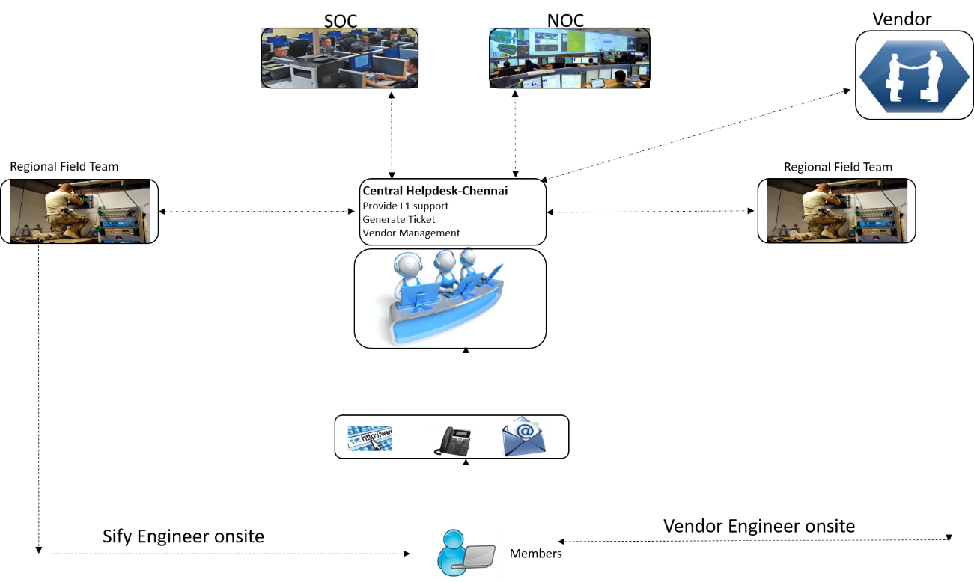
HELPDESK MANAGEMENT
Helpdesk Responsibilities:
Sify HelpDesk operates 24 x 7 x 365 for the Enterprises
Will be an interface between the technical support teams within the NOC and all the other external agencies
Will provide a streamlined communication channel between the Sify NOC-field teams and others.
Reactive support for all incidents that are not pro-actively monitored and handled by the NOC teams
Handle queries / questions related to the network and other activities such as changes, incidents, problems etc.…
Register trouble tickets based on e-mails and phone calls received and provide reference IDs
Provide status information on service outages, restoration actions, and security incidents
Members will be provided an dedicated 1800 series Toll Free number with redundant PRI lines for any network related Incident or Problems

Slide 21
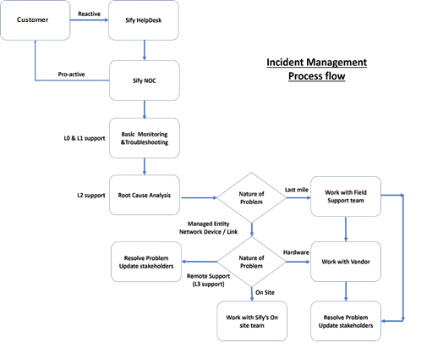
INCIDENT MANAGEMENT
  Incident Management Responsibilities:
The Help Desk team will be responsible for handling incoming complaints from the Bank and register a trouble ticket
Helpdesk team will work towards first call resolution considering the nature and complexity of issues that are reported.
Helpdesk team coordinates with L2/L3 & field teams for incident updates and for resolution.
L2 support analyze the incident and do the root cause analysis.
Each incident will get raised based on the severity of the issue.
Following are the high level severity definitions for the enterprise customer.
Severity 1 - Critical
    Power issue at the site
    Device failure
    Link Down etc.…
Severity 2 - Major
    Line Upgrade
    New Line
    Performance Issue etc.…
Helpdesk raises Incident ticket with proper problem code with severity in Oracle CRM tool

Slide 22
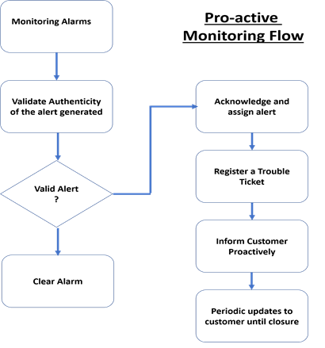
PROACTIVE MONITORING
  Proactive Monitoring Responsibilities:
  Monitoring team monitors the network through Sify NMS tool.
  Monitoring the availability of the Network
  Monitor the alarms being generated on the “Alarms” Tab
  Verify the validity of each of the alarm by doing a manual check, Ping to the destination or log into the device to verify the authenticity of the alarm
  If it is a false alarm, clear the alarm.
  If the alarm is valid and an issue is observed, raise a trouble ticket on the oracle CRM ticketing tool and follow the incident management process
  Right click on the alarm and “Acknowledge” and “Assign” the alarm for an engineer to work on

Slide 23
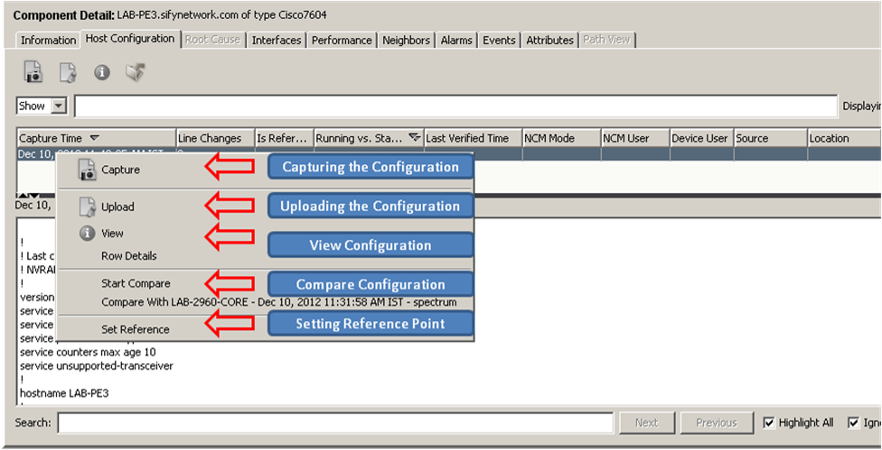
CONFIGURATION MANAGEMENT
  Configuration Management Responsibilities:
  NOC engineer ensures the Bank’s network device configuration periodically
  Automated Scheduling will be enabled to take configuration backups on daily basis.
  NOC engineer checks number of success / failure backups daily and troubleshoot the failed cases and reinitiate the backup.
  NOC engineer uses the device configuration to restore when there is a software crash, hardware replacement and hardware failure cases.
  NOC team uses configurations to resolve routing and VPN problems etc.…
  NOC team do the comparison and validation to ensure standardization of the Configuration and can be used to roll back the configuration after any change management.
  Rolling back changes to a previous configuration if results are unsatisfactory.
  Software versions control and management
  Sify keeps last 90 days Configuration backups for each device in central repository.

Slide 24
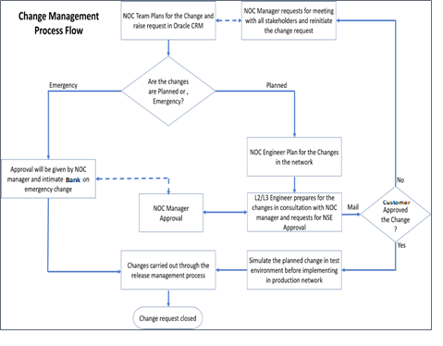
CHANGE MANAGEMENT
  Change Management Process & Responsibilities :
  NOC team raises Change request in Oracle CRM system and track the request through defined approval (internal and the Bank) process and ensure change request will complete as planned.
  Planned Change Requests:
  NOC team initiate the change and develops, plans, and executes the steps necessary to meet the initial requirements for a Request for Change (RFC).
  L2/L3 engineer prepares the action plan with consultation with NOC manager
  Change request will get approved by the Bank and NOC manager to implement the change.
  Carrying out changes in the Network as approved in the Change Management
  Perform post implementation review
  Emergency Change Requests:
  Approval will be given by the emergency Change advisory board rather than waiting for a CAB meeting.
  Testing will be reduced, or in extreme cases forgone completely, if considered a necessary risk to deliver the change immediately.
  Documentation, such as updating the change record and configuration data, will be deferred, typically until normal working hours.

Slide 25
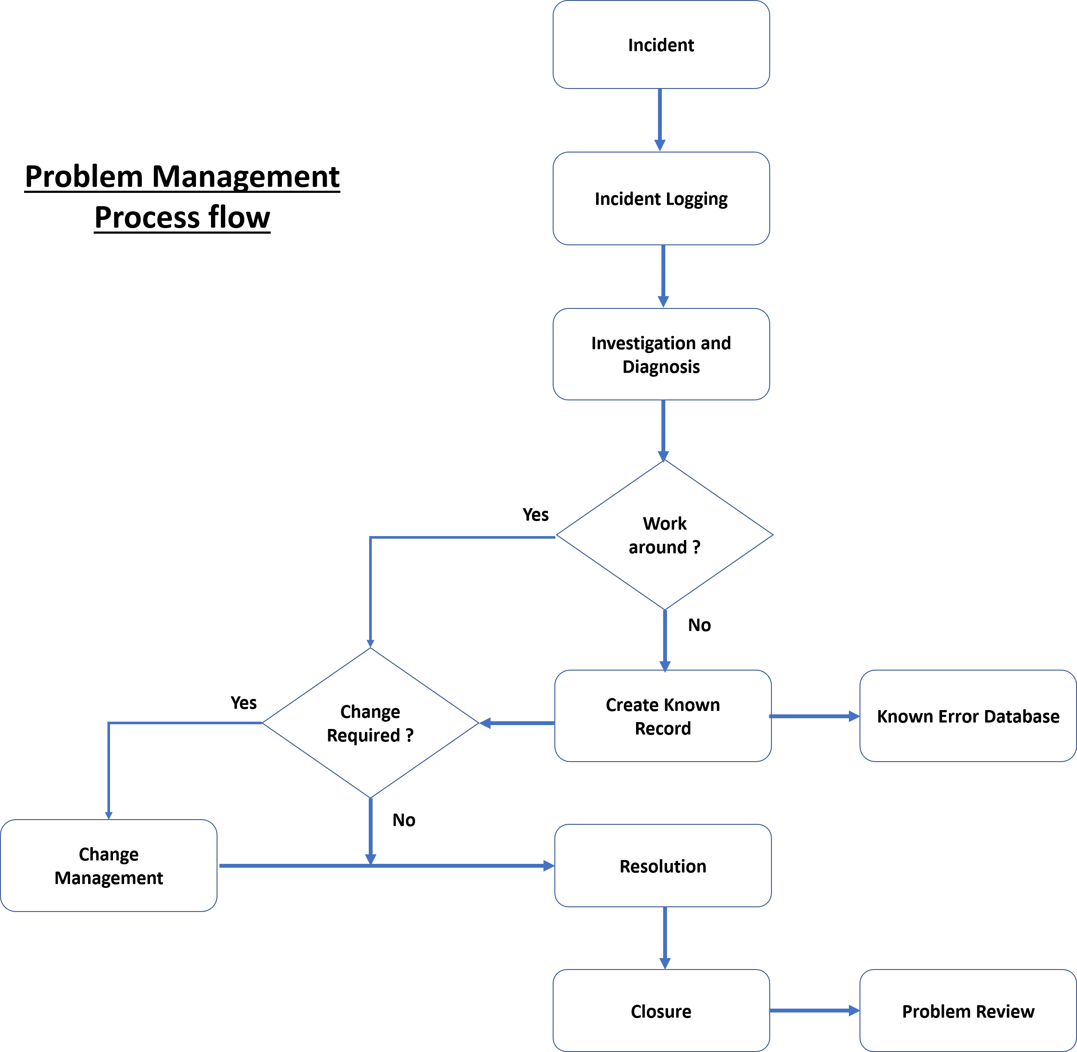
PROBLEM MANAGEMENT
  Problem Management Responsibilities:
  The NOC team will systematically analyze the incidents that have affected the availability and performance of the network in order to identify the problems
  Priorities will get assigned in the problem investigation process, and diagnosis of root cause.
  All workarounds that have been provided to fix a particular incident will be updated in the knowledge base
  Any incident resolution would involve referring the database to identify known fixes for the incident
  Based on the recurrence of incidents and the applied workarounds, the service desk team will identify potential problems through correlating information or attributes of multiple incidents or a single type of incident experienced multiple times.

Slide 26
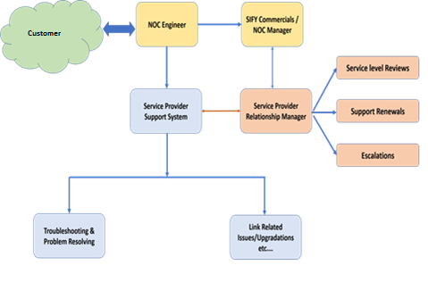
VENDOR/PROVIDER MANAGEMENT
  Vendor/Provider Management Responsibilities:
  Coordinate and follow-up with all the relevant providers of the links to ensure that the link related issues are resolved in accordance with the SLA of the respective provider.
  Sify has back to back arrangement with providers for the support and maintenance of the link being maintained.
  Sify will ensure that unresolved items are escalated in accordance with the escalation matrix.
  Publish consolidated monthly SLA performance report, time taken across providers for consideration of the Purchaser and pendency with time details.
  Log calls with providers for problems coordination and follow up with the providers to get the problems resolved.

Slide 27
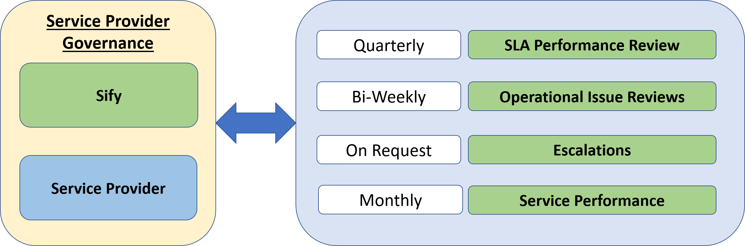
SERVICE PROVIDER GOVERNANCE
  Service Provider Governance:
  Performance of service provider will be measured on monthly basis.
  Sify has back to back arrangement with providers for the support and maintenance of the link being maintained.
  Bi-Weekly and Monthly meetings are also held for getting the updates about the operational issues.
  Ensure that the relationship and the services offered by service provider are managed effectively.
  Monthly reports of each link to measure link performance of the service provider

Slide 28
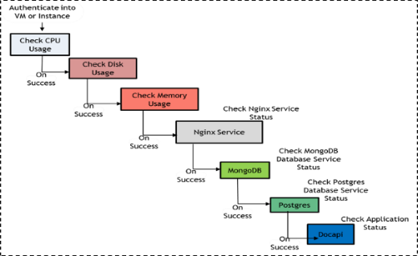
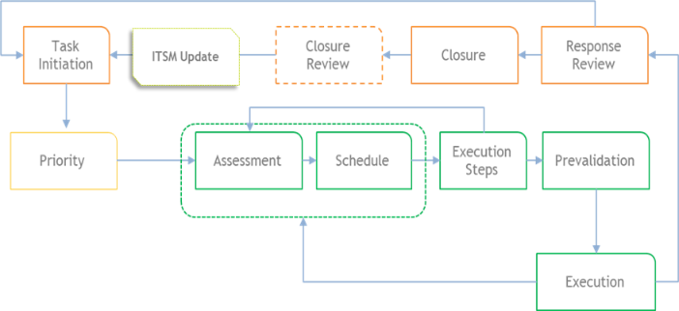
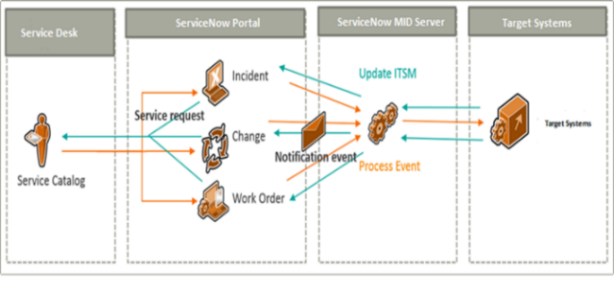

Operations Automation
Workflow automation
Run Book automation
Service desk integration
75% of incidents resolved at first contact
13% of incidents are resolved with automation (without any human touch)
      Outbound call to customer contact for First level troubleshooting (FLT)
                Auto FLT before a ticket is assigned to Agent
Alarm suppression based on entity mapping
Runbook automation for ticket resolution
Notes:
Unified Monitoring - Routers, switches, firewalls, SDWAN through SNMP, logs, ICMP, TCP, HTTP, NetFlow, CLI plugins and API.
Alerting console with event correlation, context with ML based alert suppression, prioritisation and deduplication. Dashboard for statistics and reporting.
Anomaly detection with predictive intelligence for capacity and network performance with dynamic thresholds.
Improved operational efficiency and optimize performance
Reduced probability of errors by minimizing human interface
Lower operational expenses - passing on the cost reduction to end customers
Improved agility and scalable solutions

Slide 29
SIFY TOOLS

Slide 30
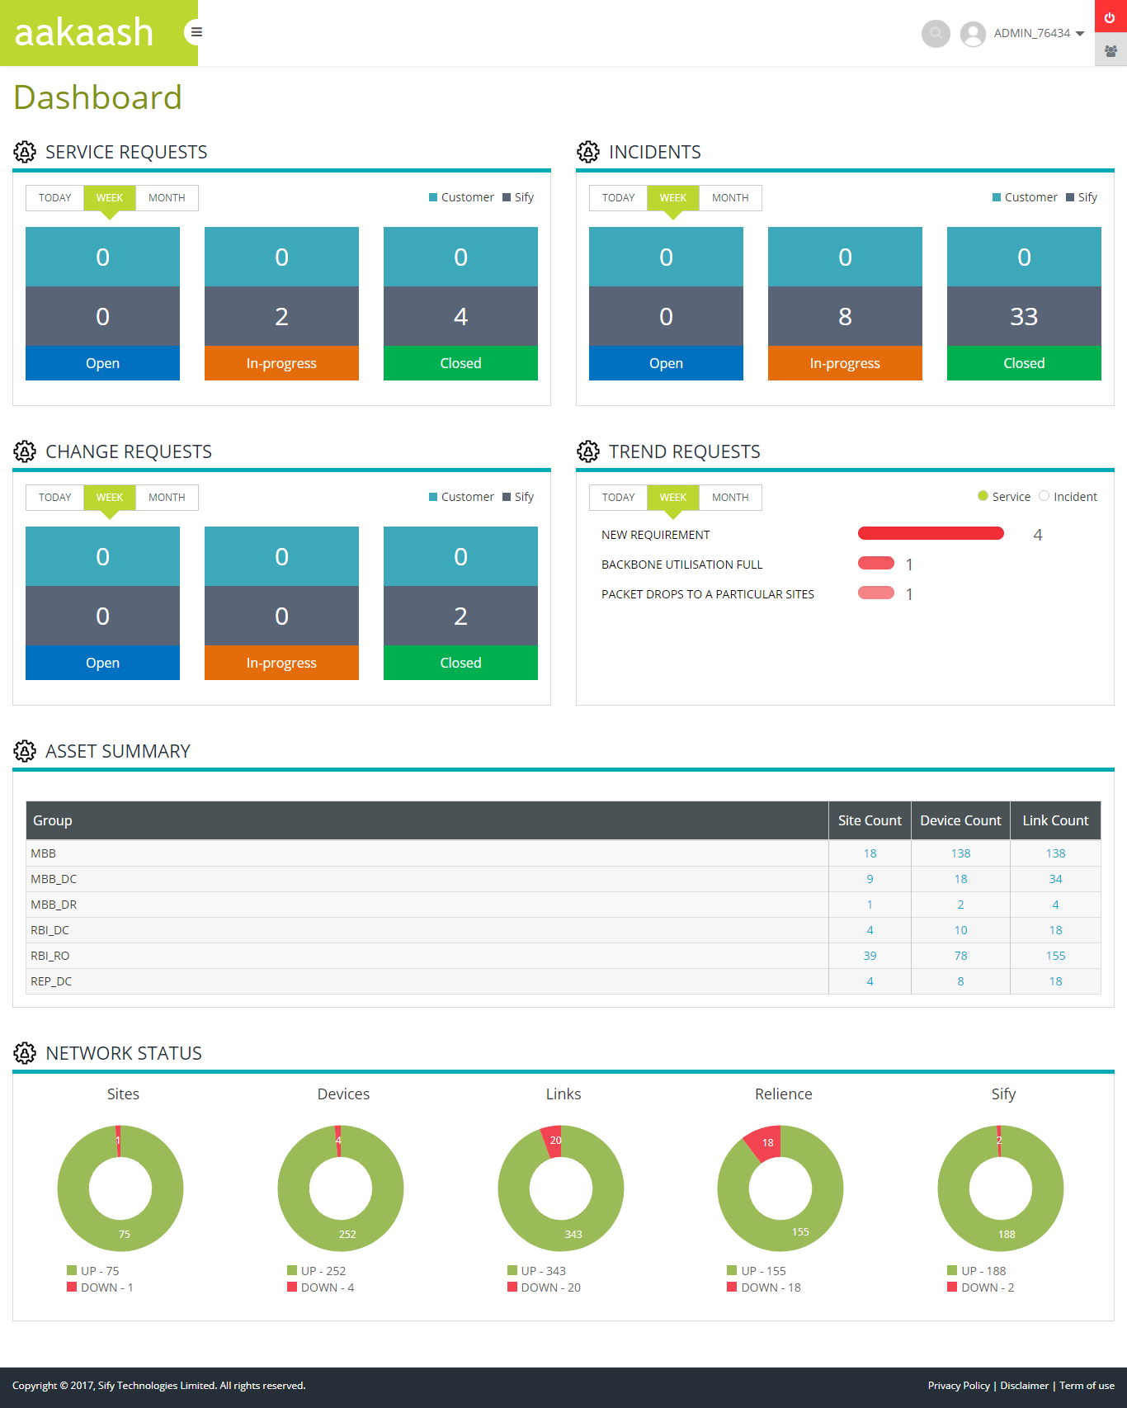
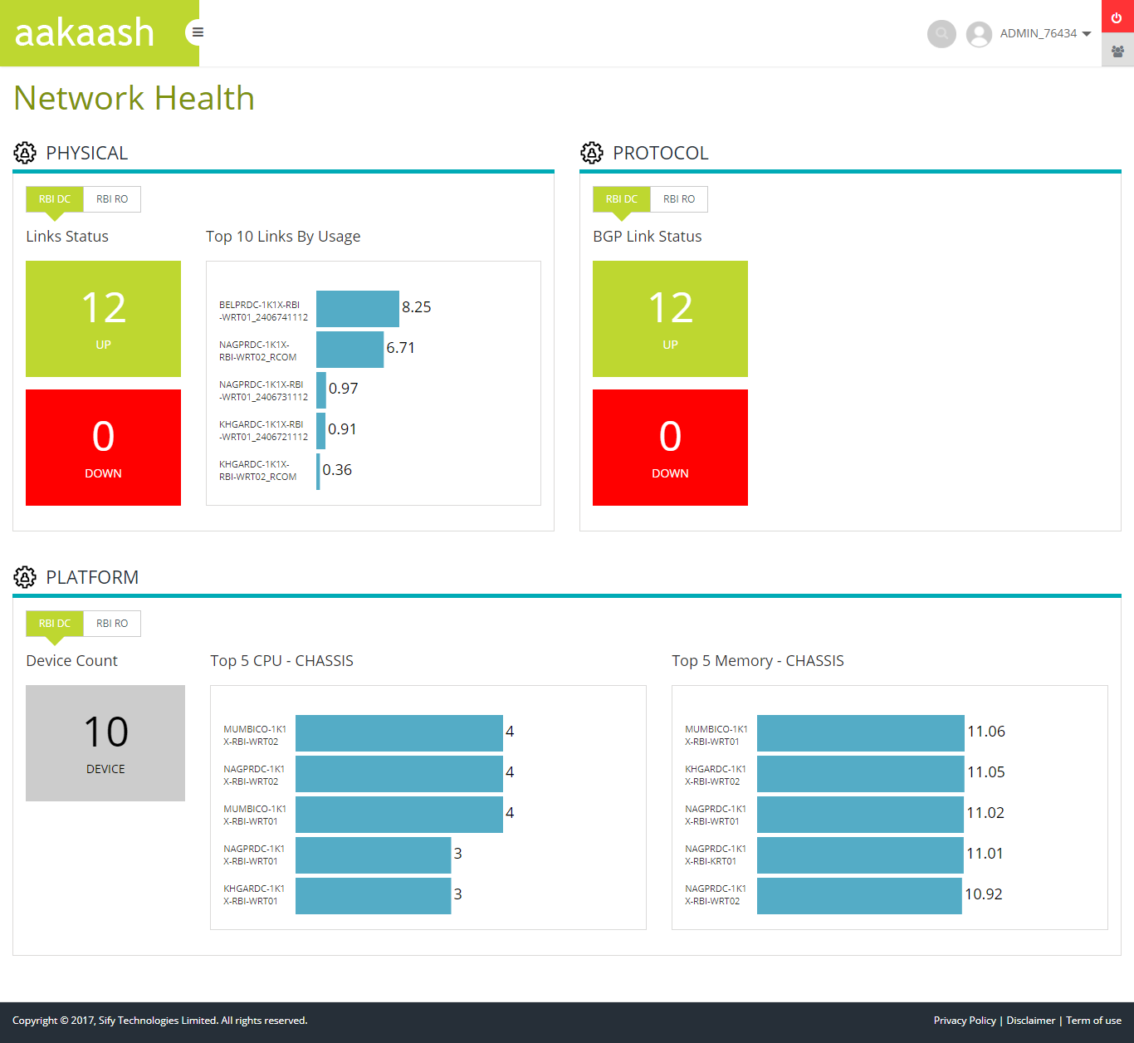
Dashboard & Health Status

Slide 31
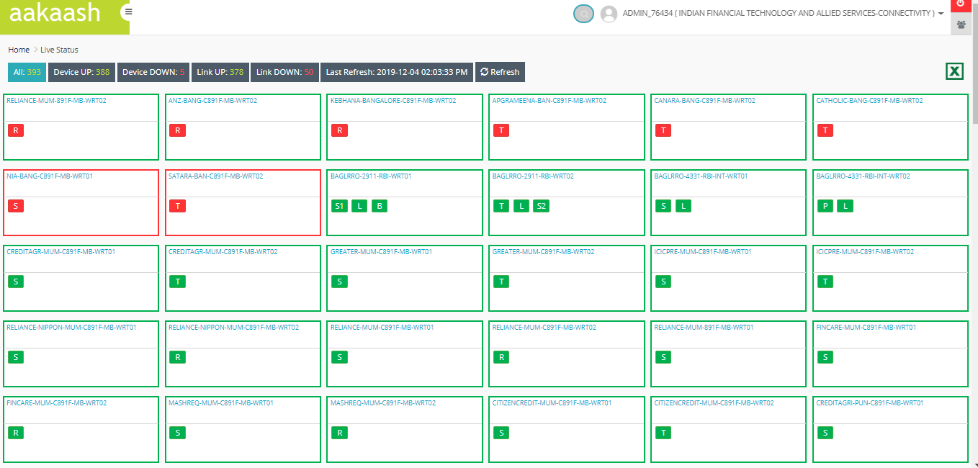
Topology view

Slide 32
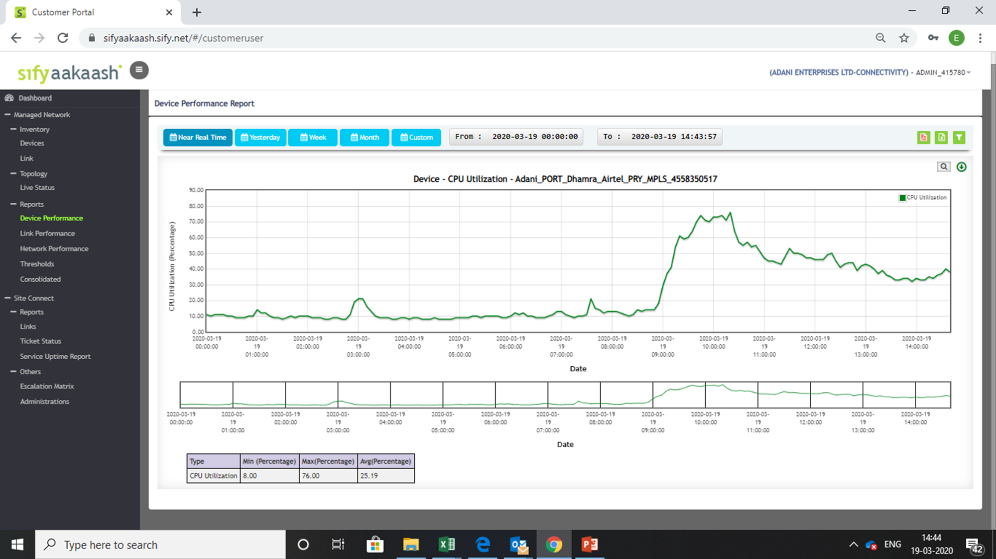
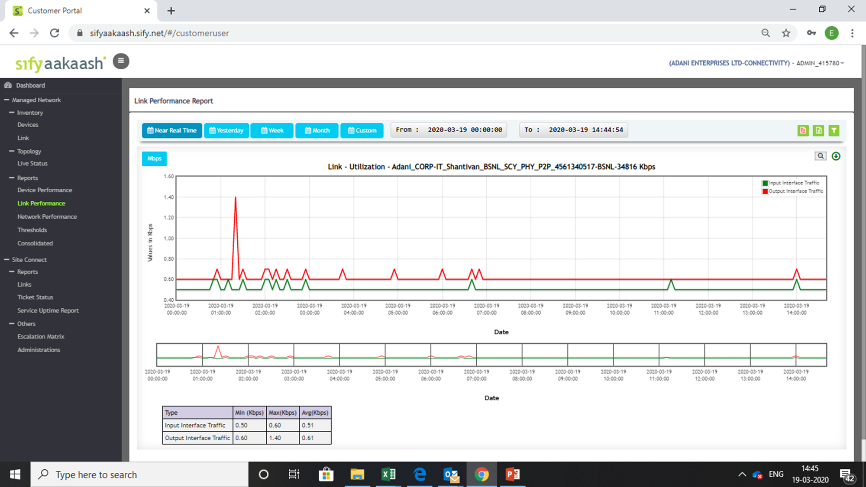
tool DASHBOARD

Slide 33
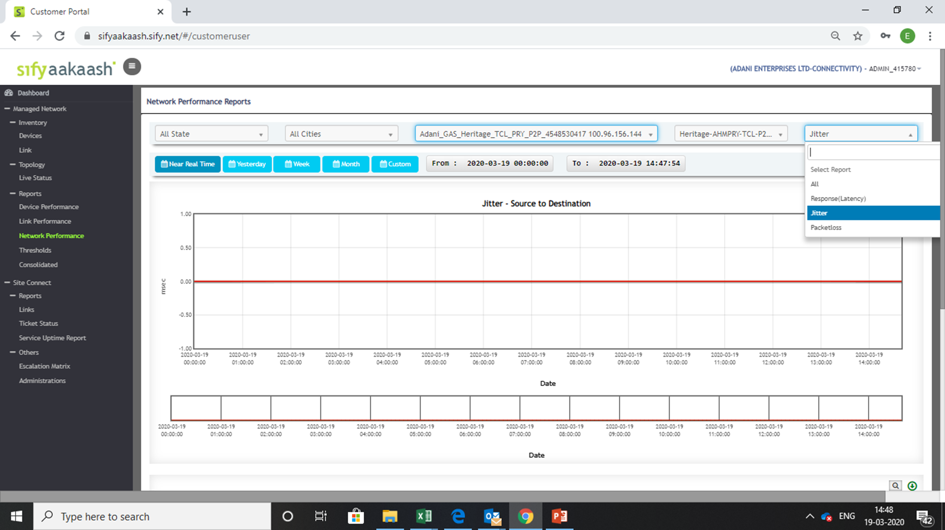
Performance reports

Slide 34
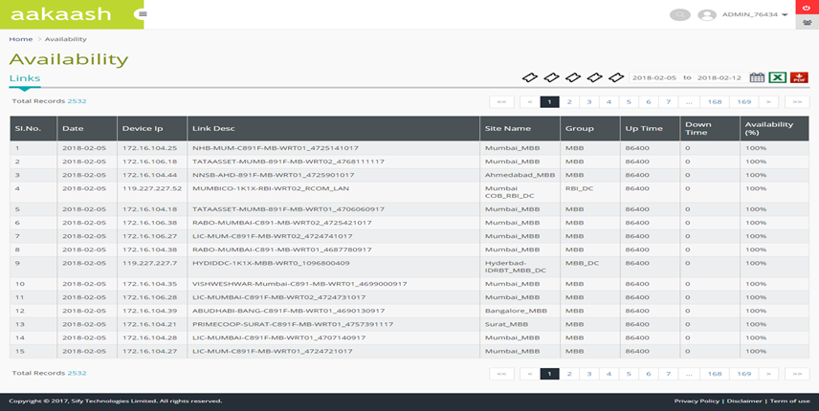
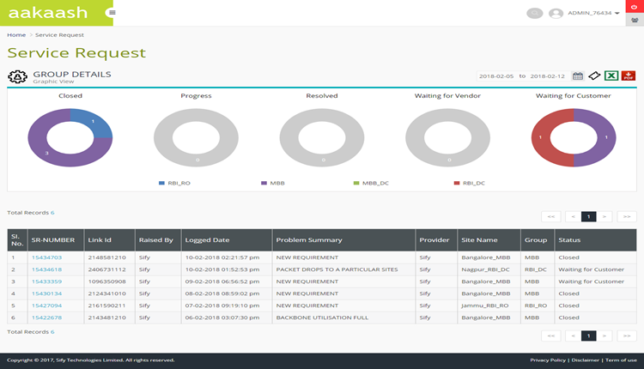
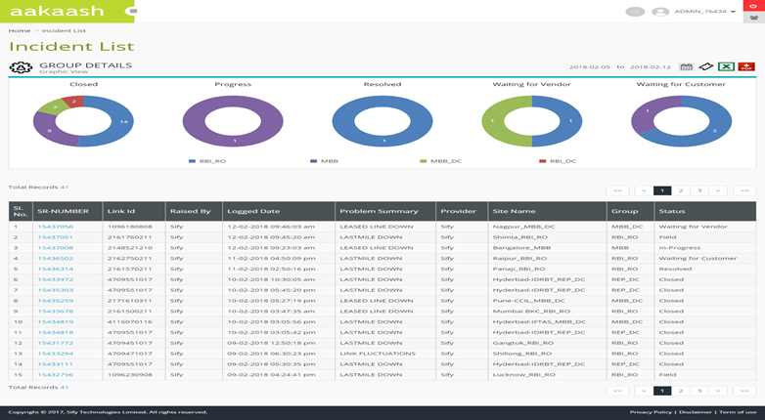
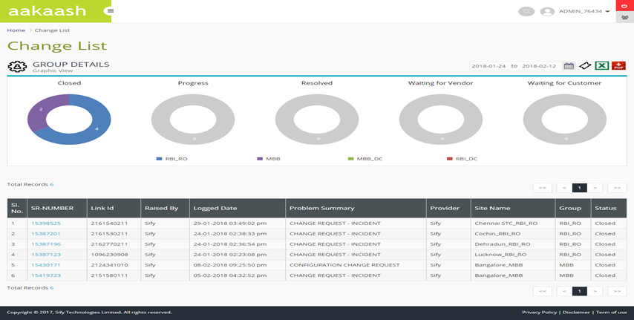
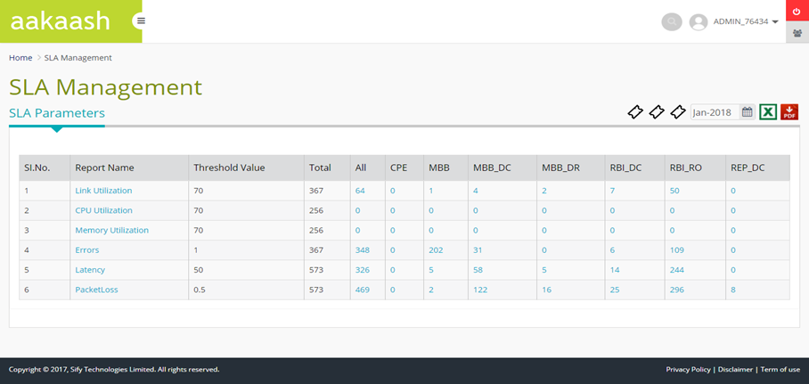
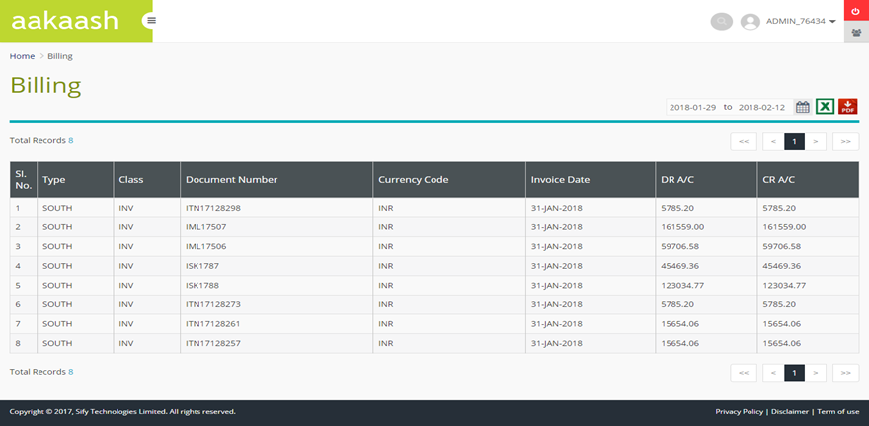
OTHER reports

Slide 35
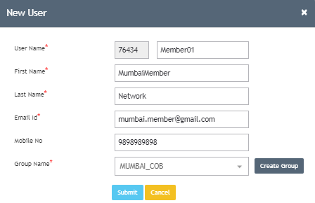
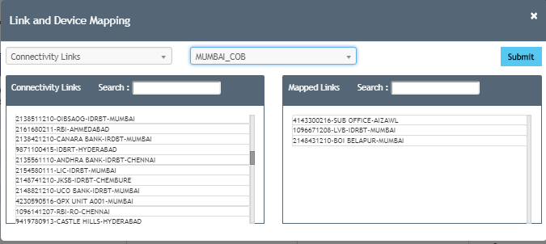
ACCOUNT MANAGEMENT
  On Boarding Customer BU Account
  Customer Admin account will have complete privileges to Create/Modify/Delete BU users
  Customer admin can map specific assets to each BU account.
  Dashboard view parameters can be mapped for each BU account

Slide 36
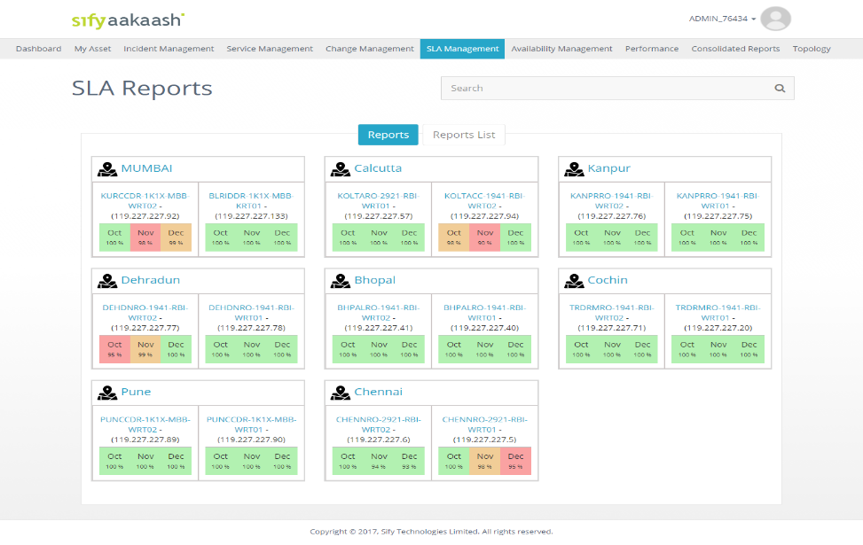
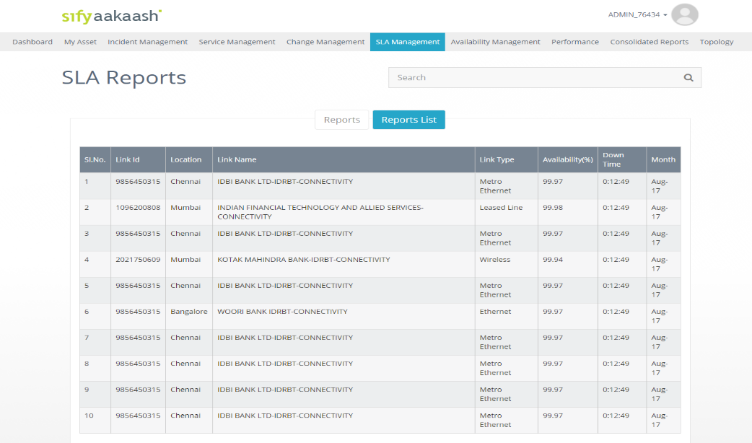
SLA Management
  SLA Management Reports
  Customer will have complete view of BU-wise and Link SLA reporting as shown in the below screenshots.
  This module provides historical 3 months SLA trend for each site and per device:
  SLA Reports are available in Graphical form and in Tabular form as shown in the below screens.

Slide 37
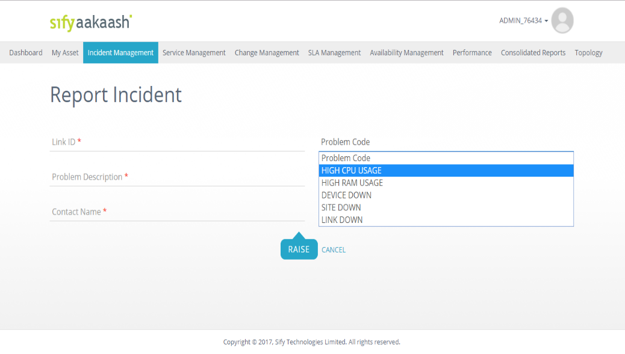
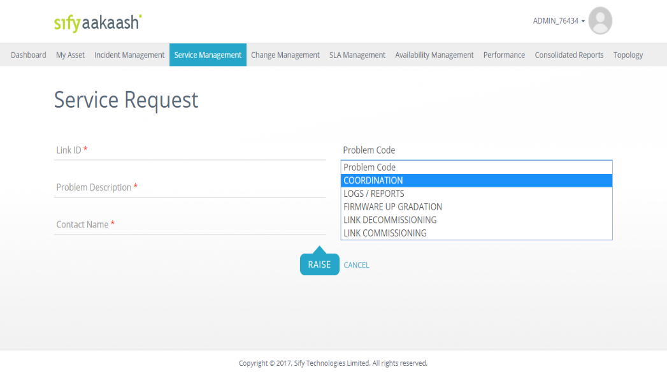
Service Management
  Service Management
  Customer and its business teams can raise Incidents / Services from service portal from their respective user accounts.
  Customer can raise service requests for link commissioning / decommissioning, upgradations etc.… and will have the complete visibility of service status for each request
  Customer can report incident from this module, and they can track the incident till the closure.

Slide 38
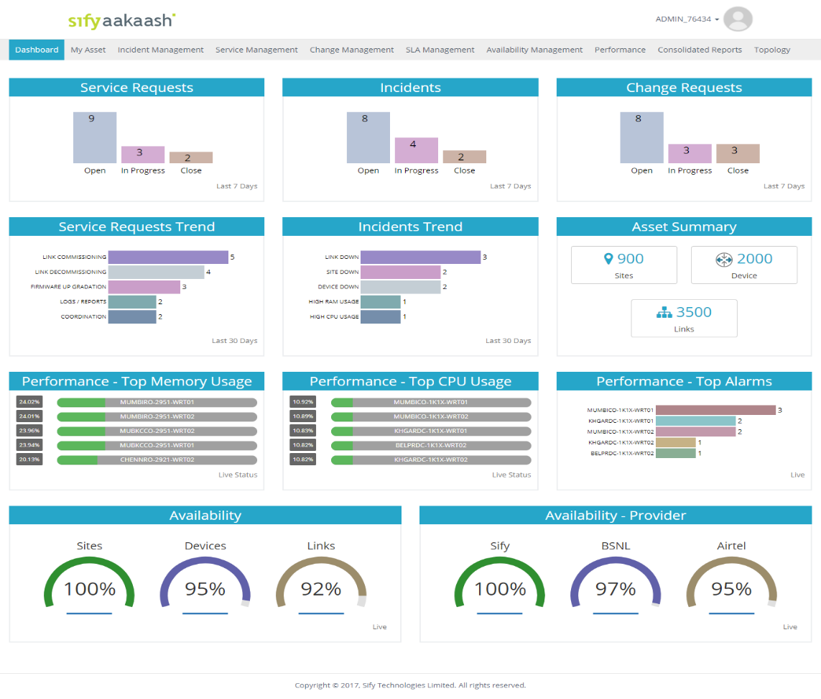
Customer Self Service
  Customer Service Portal Highlights:
  Sify Aakaash Portal is customer facing portal that offers integrated view of the Service requests, Network performance Reports, Inventory and trouble tickets that have been registered for the issues reported and identified pro-actively.
  All the incidents and changes are recorded through the system for the Banks visibility as well as for analysis
  Enhanced real-time and scheduled reporting based on defined configuration

Slide 39
SIFY NETWORK MANAGED SERVICES

Slide 40






NETWORK OPERATIONs
Global Network Operations Center located at Chennai, India
Global Service Operations Team based at Hyderabad and Mumbai, India
Compliant with international standards
Dedicated setup for large customers’ mission-critical networks
Sify’s resources
Varied functions like Advanced Solutions Group, Service Operations Team, WiFi Mgmt, DDoS Mgmt, Core NetOps
People strength of 500+ including FMS teams
Key highlights
664 Managed Enterprise customers
37,347 managed links on the shared platform
52,495 DoP, 4,500 NSE/IFTAS, 8,000 Syndicate Bank managed links on captive setups
29,451+ managed routers on shared platform (36,123 DOP, 2,100 NSE)
WLAN – 12 customers, 232 Switches, 11 Controllers ,1972 APs , 195 sites
LAN – DOP (8800), Syndicate Bank (6000), UIIC (1150)
Best practices
Integrated management functions
Service Provider agnostic Managed Services
Automation
Proactive monitoring & management
Customer communication during network events
BCP drills, mock drills
SD-WAN – 2200+ end points, 3 OEM multi-tenant platforms
Service Desk - 1380 calls per day
Ticket volumes – 2100+ per day
Notes:
Network Services - Over two decade of experience in building and managing complex Networks. Managing 80000+ endpoints. Commissioned World’s largest MPLS Network.
Data Center - 19+ years of experience in running Data Centers at highest SLA compliance levels. 6 Tier III, 12 Tier II and 10 State Data Centre's (BOT)
Comprehensive Cloud Portfolio & Strategy - Cuts across, advisory, implementation & transformation
Disaster Recovery - Experience of setting up / running disaster recovery infrastructure on a private / DRaaS model
Security Services - 500 Devices, 140 Customers managed from SOC. Strong Information security and System Integration practice
Managed Services - 12+ years’ experience in running DC, DR, Network, Security, Applications on Managed Services Model
Technical Skills - Credible partner with technical skills across the ICT spectrum, including software. Highly skilled team with expertise around all OEM products, Tools and services
Service Provider Agnostic - Neutral Player with Access to all Service Provider
NPM, APM, Digital Exp Monitoring (various tools talk to each other)

Slide 41
SIFY’S MANAGED SERVICES SCALE
 | Total Resources | Technical skill sets
Network engineering and solution | 47 | CCNA + CCNP + CCIE
SDN CoE | 32 | Dev Ops, Scripting, Tools, Network Management, ITIL
Central NoC | 150 | CCNA + CCNP
Service operations | 40 | CCNA + ITIL
Service operations – Field PMO and project managers | 1317 32 | PMP, Prince, CCNA
SDM Service desk Infrastructure operations | 177 115 80 | ITIL CCNA
Deep Engineering Expertise
  De-Integrated SDN CoE
  Advanced L2/L3 Engg
  L1 teams trained in FLT on diverse media
  Experience in deployment of Hybrid Management models
  ep Cisco expertise – CCNA, CCIE
Project Management
PMI framework-based Project governance
Dedicated Project team for planning & Control
Integrated tools to track, monitor and report on the project
Dedicated Project Execution team and logistic teams
Extensive Field Teams
1300+ trained engineers on field, covering over 400 manned locations
Project teams that deliver customer centric projects
Business Relationship Management
Extensive Quarterly Business & Service Reviews
Proactive solution & service enhancement recommendations
Proactive Network cost optimization

Slide 42



CUSTOMIZED INDUSTRY LEADING SYSTEMS
§
Service portal
§
Service desk.
§
Tickets & service
requests.
Service management
§
Incident &
ITIL Support & CSP
Problem
management.
§
SLA management
CMDB
§
Organization wide SOR
Asset
•
Intelligent event
management
§
correlation.
Change
•
Faster root cause
Event Management
Management
analysis.
Service context
§
RF health
Wi
-
•
Fi coverage.
•
Change management
§
User and
Network modelling
•
Mobile device
•
device.
performance
& Monitoring.
Performance
Visual
•
Wireless
•
Network Topology
Spectrum
Airwave
§
analytics.
Inventory.
Network Fault and
manager.
controller
•
Wireless
management.
•
Network Config.
Event management
Network health
•
Wireless
monitoring system
Management
network health
•
Operation analytics.
§
Wireless
Traffic analysis
•
Contextual
•
topology
SNMP
Log
SNMP
•
Configuration
diagnostics.
Flow
§
AP health and
CLI
management.
API
performance.
•
WLC
§
Analytics.
Wi
management.
-
WAN
LAN
Fi

Slide 43
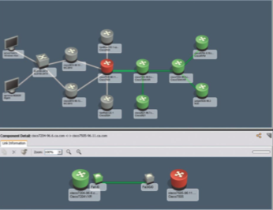
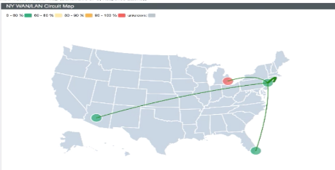
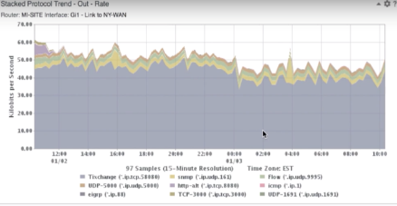
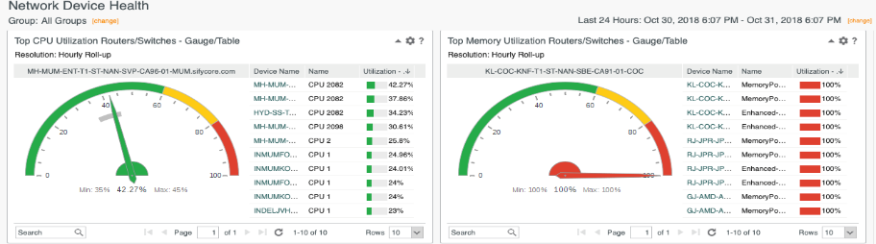
Network Management THROUGH DEEP INSIGHTS
WAN overview
Link contexts with application traffic & device health
Visual root cause analysis

Slide 44









CLOUD-HOSTED & CLOUD-DELIVERED
Network Management systems
Ubiquitous access on the Sify Network
Highly reliable and resilient infrastructure
Flexible to scale
SIFY MPLS BACKBONE
Sify BANGALORE
Sify MUMBAI
NOC/SOC Facilities
Tier 3 Datacenters
Backbone on-net sites with multiple provider presence.
Seamless access to the managed assets
Sify Chennai
Sify Hyderabad

Slide 45
OUR Value Proposition
1
3
5
Connectivity-centric to App centric
Facilitate & manage performance
Difficult to simplified operations
Hybrid WAN, Topologies, Physical/Virtual, convergence
Visibility & Analytics
Cloud perimeter branch and user security.
Discover, understand needs and manage performance
Cloud Enablement
Automation, programmability, consolidation and agility
Inflexible to Flexible
Behaviours, Trends and feedback loops
Security
2
4
6
Managed services to drive efficiencies, lead engagements through insights and
value beyond cost economics.

Slide 46
CASE STUDIES:
LARGE SCALE NETWORK TRANSFORMATION PROJECTS

Slide 47







DEPARTMENT OF POSTS: LARGEST MANAGED NETWORK IN INDIA
Financial BANKING
Project Objective
To connect 30,000+ Post Offices across India for Digitalization of DoP
Integrated Value and Outcome
Sify was able to outclass competition in a techno-commercial evaluation model by virtue of the following:
Sify was rated as T1 because of combined value of integration, managed services and infrastructure solution richness.
Value for Client
A significant percentage of the total commercial value was Sify’s inhouse Services including Network Infrastructure Services. This resulted into lower TCO (for the client), higher EBITDA for Sify (by virtue of monetization of network infrastructure and NOC investments)
Value for Sify
This project enabled Sify’s entry into large network integration and managed services engagements vis-à-vis Sify’s earlier position in the market as a network infrastructure service provider.
This space was earlier dominated by the likes of IBM, DD, Wipro and HCL.
Project Model
Managed Services led Opex model
Competition
IBM, DD, Wipro, HCL, TCS, Tech M
MANAGED NETWORK SERVICES
Sify’s Uniqueness
Integrated value of skills - NI, Project Management, NOC & Managed Services, Security Services alongside Network Infrastructure services
Contract Duration
7 years – large annuity revenue stream

Slide 48

IFTAS: BACKBONE FOR INDIA’S INTERBANKING SERVICES
Financial BANKING
Project Objective
To set up the Digital Payment Network Infrastructure connecting RBI locations and Member Banks, for Interbank Financial settlements.
Integrated Value and Outcome
Sify was able to outclass competition in a techno-commercial evaluation model by virtue of the following:
Sify’s expertise to design , implement and operate a multi service provider environment to provide for high availability.
Ability to tightly integrate security controls into the overall Network architecture , and yet manage the complexity of interconnections between member banks and RBI payment gateways.
Integrated Play of Network Managed Service Provider & skillsets to run large scale Dedicated NOC operations for such mission critical Network.
Value for Client
Single ownership with the MSP to manage the complexity and guarantee high availability.
Value for Sify
This was a great showcase and reference for Sify for demonstrating skillsets to manage complexity, and for other Network Outsourcing opportunities.
Project Model
Managed Services led Network Outsourcing model
MANAGED NETWORK SERVICES
Competition
Airtel, Reliance Communications, Tata Communications
Sify’s Uniqueness
Integrated value of skills – NSP, Network Integrator, NOC & Managed Services, Network Transformation Services, Security Services alongside Network Infrastructure services
Contract Duration
5+2 years

Slide 49

NSE: THE SECOND LARGEST STOCK EXCHANGE IN THE WORLD
Financial STOCK EXCHANGE
Project Objective
To transform and transition the NSE existing Network , Setup a Shared NOC & SOC , and expand the NSE footprint to acquire more members in India.
Integrated Value and Outcome
Integrated Play of Network Managed Service Provider , Network Integrator & skillsets to run NOC operations for such mission critical Network.
Value for Client
Provided NSE a predicable model to scale operations over 40 cities from 7 city presence using Network and Edge assets. This has helped significant growth in member acquisition and lowering the cost of operations for existing members.
Digital Platform for Service Operations and member interactions between members and NSE enabled transparent and efficient operations.
Value for Sify
Monetization of network and edge assets.
Positioned Sify as a strategic partner to NSE and opened engagements in areas of Cloud and DC.
Project Model
Managed Services led model
MANAGED NETWORK SERVICES
Competition
IBM, NTT, Wipro, Tech Mahindra
Sify’s Uniqueness
Integrated value of skills – Network Integrator, NOC & Managed Services, Network Transformation Services including Design, Optimization and Transitioning of the Network.
Contract Duration
5 years

Slide 50

TATA STEEL: DIGITAL NETWORK FOR INTEGRATING IT, OT & PEOPLE
MANUFACTURING
Project Objective
To establish a NOC integrating IT, OT assets to enable insights into the Network across DC, Cloud and End users.
Build and Operate a Private Network across all Campuses
Integrated Value and Outcome
Specialized skillsets and processes across NOC setup & managed services outclassed the traditional IT outsourcing model deployed by the incumbent.
Mwifi platform integration with TSL’s Access & Identity Management System (AIMS), ensured an integrated Platform for all IT, OT assets, as well as Wearable Safety devices across TSL’s workforce.
Value for Client
The NOC has enabled network orchestration and analytics for the client across his IT & OT assets, which in turn has resulted in better efficiency & control.
Sify’s Private Network has enabled large scale sensitization of plant operations leading to better efficiencies and significant cost savings.
Value for Sify
This project has given Sify deep insights & experience into future roadmap on 5G and edge computing.
TSL has also chosen Sify for migration of workloads to public cloud and integration of public cloud environment with TSL’s legacy infrastructure.
Project Model
Managed Services led Opex model
MANAGED NETWORK SERVICES
Competition
IBM
Sify’s Uniqueness
Integrated value of skills - NOC & Managed Services, Edge Transformation Services
Contract Duration
5 years

