Slide 1
Empower your Enterprise with Intelligent Network Services
December 2020

Slide 2
AGENDA
BUSINESS & TECHNOLOGY TRENDS
INTELLIGENT NETWORK SERVICES – CONTEXT WITH NETWORK TRANSFORMATION
NEW-AGE NETWORK ARCHITECTURE AND DESIGN
NETWORK ARCHITECTURE FOR ANYWHERE DATA CENTER
NETWORK ARCHITECTURE FOR HYBRID WAN & APPLICATION PERFORMANCE
NETWORK ARCHITECTURE FOR CENTRALIZED VISIBILITY & CONTROL
SIFY SUCCESS STORIES
KEY TAKEAWAYS
2

Slide 3
Major Global Business Trends leading to increased demand from networks
Hyperconnected enterprises
Digital business transformation
Automation and robotics
Multitude of connections for geographically distributed people, processes, and devices
Increasing adoption of hybrid and multi-cloud among global organizations
Need of a scalable network to deliver top-tier services to customers across the globe
Organizations looking to leverage Cloud-native technologies (analytics, IoT, AI, ML)
Organizations looking to develop new processes, services, and models
Need of an intelligent and adaptable network for new requirements and DX
Enterprises rely on automation, robotics, and RPA to improve CSAT, QoS, efficiency
The trend will continue to grow in the pandemic-stricken world
Enterprises will need round-the-clock network availability and reliability

Slide 4
Major technology trends powering fundamental network transformation
Applications being modularized and distributed across Clouds
IoT and M2M integration with mainstream networks
Pervasive
mobility
Immersive video experience

Slide 5
Major technology trends powering fundamental network transformation
Software applications being modularized and distributed across public Clouds and network edge
The network must transform to:
Provide improved application performance
Be agile, seamless, secure and responsive to dynamic application landscapes
Mobile users will continue to grow in the coming years
The network must transform to:
Ensure round the clock anytime, anywhere high-performance connectivity
Provide access to applications on Cloud from private devices over Wi-Fi or 4G networks
Strengthen Edge connectivity to diverse and distributed user base
Applications being modularized and distributed across Clouds
Pervasive
mobility
Exponential rise in number of IoT devices highlighting the need of smart Machine-to-Machine communication
The network must transform to:
Provide connectivity to all the IoT devices
Integrate devices smartly with mainstream networks
Enterprises are looking to leverage the power of digital media technologies, VR, AR, and immersive 3D environments
The network must transform to:
Ensure top-tier user experience
Meet network demands of low-latency communications
Provide end-to-end bandwidth and dynamic performance controls
IoT and M2M integration with mainstream networks
Immersive video experience

Slide 6
TRANSITION TOWARDS INTELLIGENT NETWORK
Expectations from intelligent network services
ESTABLISHES THE FUNDAMENTAL NEED FOR NETWORK TRANSFORMATION
Support fast-changing set of users, applications, devices, and services and unify them intelligently
Key aspects of Network Transformation:
Seamlessly connect between distributed IT assets and applications in a DC and hybrid multi-cloud environment
Network rearchitecture for distributed hybrid and multi-cloud landscape
Deployment of software controls (SD-WAN) to make the network operations and control smarter
Leverage Software and other functionalities to control, rather than physical access and distributed policy control
Intelligence of what is flowing the network for better decision-making capability
Leverage the cutting-edge technologies and algorithms to collect, assimilate, analyze and visualize networking information in real time

Slide 7
WHAT ANALYSTS ARE Saying
By 2024, 50% of network operations teams will be required to rearchitect their network monitoring stack, due to the impact of hybrid networking.
By 2025, 50% of all organizations will use cloud-based network management platforms as the primary method for configuring and supporting their networks, up from less than 15% today.
By 2025, to enhance agility and support for cloud applications, 65% of enterprises will have implemented software-defined wide-area networks (SD-WANs), compared with about 30% in 2020.
In 2021, spend on SDWAN will surpass spend on traditional branch office routers
Most networking leaders struggle with network automation progress, since only 26% maintain accurate network data, severely stalling and limiting the effectiveness of these initiatives.
By 2025, 30% of all organizations will rely on AI and ML-based network management and control systems to augment network operations and troubleshooting tasks, up from less than 5% in 2020.
Source: Gartner

Slide 8
NEW-AGE NETWORK ARCHITECTURE AND DESIGN

Slide 9
WHAT TO TRANSFORM IN YOUR NETWORKS?
I
II
III
Network architecture for anywhere data center - Cloud & IOT Ready Networks
Hybrid WAN & application focused Network Architecture - Optimizing multi-cloud connectivity
Centralized network management - visibility, control, and insights
Data Center Interconnects
Hyperscale Cloud Connects
Internet Exchanges
Network orchestration and analytics
Single pane of glass
Integrated tools on a single orchestration layer for visibility of Network + IT assets (integration of WAN + LAN)
Centralized control/performance focus through SD-WAN
Network Optimization through Active-Active configurations

Slide 10
I
Networking architecture for anywhere data center

Slide 11
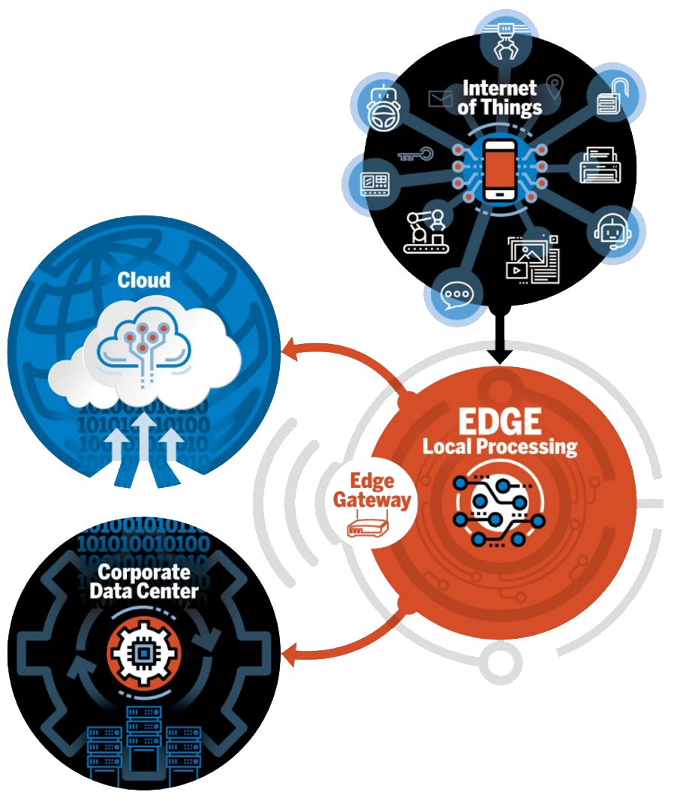
Networking architecture for anywhere data center – WIP
Nowadays, applications and data are hosted across:
Organizations need new networking architecture:
Data Center
Clouds
Edge environments
That is Cloud-ready to drive digital transformation
That facilitates faster and safer modes of data transfer across DC, Cloud & Edge
That meets application connectivity demands
That is IoT-ready to bring edge computing closer to devices
That ensures technology & operational consistency across locations
Notes:
Edge computing is transforming the way data is being handled, processed, and delivered from millions of devices around the world. The explosive growth of internet-connected devices – the IoT – along with new applications that require real-time computing power, continues to drive edge-computing systems.
Faster networking technologies, such as 5G wireless, are allowing for edge computing systems to accelerate the creation or support of real-time applications, such as video processing and analytics, self-driving cars, artificial intelligence and robotics, to name a few.
While early goals of edge computing were to address the costs of bandwidth for data traveling long distances because of the growth of IoT-generated data, the rise of real-time applications that need processing at the edge will drive the technology ahead.
What is edge computing?
Gartner defines edge computing as “a part of a distributed computing topology in which information processing is located close to the edge – where things and people produce or consume that information.”
At its basic level, edge computing brings computation and data storage closer to the devices where it’s being gathered, rather than relying on a central location that can be thousands of miles away. This is done so that data, especially real-time data, does not suffer latency issues that can affect an application’s performance. In addition, companies can save money by having the processing done locally, reducing the amount of data that needs to be processed in a centralized or cloud-based location.
Edge computing was developed due to the exponential growth of IoT devices, which connect to the internet for either receiving information from the cloud or delivering data back to the cloud. And many IoT devices generate enormous amounts of data during the course of their operations.
Think about devices that monitor manufacturing equipment on a factory floor, or an internet-connected video camera that sends live footage from a remote office. While a single device producing data can transmit it across a network quite easily, problems arise when the number of devices transmitting data at the same time grows. Instead of one video camera transmitting live footage, multiply that by hundreds or thousands of devices. Not only will quality suffer due to latency, but the costs in bandwidth can be tremendous.
Edge-computing hardware and services help solve this problem by being a local source of processing and storage for many of these systems. An edge gateway, for example, can process data from an edge device, and then send only the relevant data back through the cloud, reducing bandwidth needs. Or it can send data back to the edge device in the case of real-time application needs.
These edge devices can include many different things, such as an IoT sensor, an employee’s notebook computer, their latest smartphone, the security camera or even the internet-connected microwave oven in the office break room. Edge gateways themselves are considered edge devices within an edge-computing infrastructure.

Slide 12
CLOUD READY NETWORKS – HIGHWAYS FOR DATA TRANSFER IN DIGITAL WORLD
Cloud adjacency
DC Interconnect
CloudConnect
Futuristic
Fabric to enable multi-cloud applications
Microsecond latency for distributed APP and DB
High Bandwidth Ethernet Links [1G/10G/100G]
Replication – Between DC and NDR Fiber channel or Ethernet
Interconnects to AWS Azure, GCP and OCI
DC transformation – Workloads migration to Cloud [Sify or third party]
Seamless scale to 400G and beyond
Guaranteed availability
Protection with Sub 50ms

Slide 13
IoT ready network
Cloud
Data Center
Things/field devices/OT applications communicate data to IOT Gateway
IoT Gateway aggregates the IoT/Things data and communicate over internet via WIFI Gateway
Master Traffic is then communicated to Application Instance hosted on either Cloud or dedicated Data Center Infrastructure

Slide 14
What Sify Has to Offer ?
High Resilient Dual Band Network for Things Communication
IoT Edge Infrastructure
WIFI Gateway for IOT Edge Connectivity
Dual band (2.4 GHz and 5 GHz) network for data communication from sensors, field instruments and OT application interfaces (like SCADA, DCS, Historian, QMS etc.).
IoT Edge Gateway for data aggregation from Things (IoT Devices) and OT Application interfaces.
Edge Security for encryption of IoT data
WIFI Gateway for aggregated IoT Traffic and IT Application Traffic from heterogeneous sources and communicating the aggregated master traffic to cloud or on-prem infrastructure (Data Center) over public or private internet.

Slide 15
II
NETWORK ARCHITECTURE FOR HYBRID WAN & APPLICATION PERFORMANCE

Slide 16
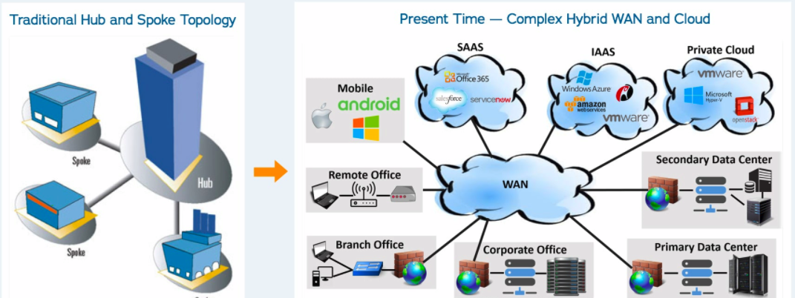
Emergence of HYBRID WAN Strategy for Hybrid and multi-cloud
MPLS offers Hub & spoke or Full mesh.
Ideal for a DC centric architecture
In a cloud & SaaS world, need newer forms
Internet increasingly used for local breakouts to SaaS Cloud paving way for Hybrid Network Architecture.
Active Configurations gaining importance - SDWAN architectures.
Notes:
Increasing use of modern IT architectures has given way to the evolution of Increasing use of Internet as connectivity option to the Cloud( SaaS And IaaS ) . The traditional hub and spoke connectivity model with Data Centers acting as hub nodes for traffic aggregation is no more relevant as Cloud and Multi-Cloud environments are acting like multiple data centers spread across the network . So the traditional DC is no more the center of the network . We can also say that Data Centers have moved to the Cloud , hence bringing greater relevance to Hybrid WAN , including MPLS and Internet complex as reliable connectivity options . From Data Centers to corporate offices, mobility to various flavors for cloud (IaaS, PaaS) Hybrid WAN has connected all of them.

Slide 17
APPLICATION PERFORMANCE FOCUSED NETWORK ARCHITECTURE
In the distributed digital landscape, networks need to be
AGILE & FLEXIBLE
Flexibility to choose service provider & technology suiting to applications
Centralized control & monitoring
Interoperability with legacy architecture
APPLICATION-CENTRIC
Application-based policies and routing with local breakout option
Application visibility & analytics
Real-time enforcement of app-based SLA
SDWAN
fulfills all these needs
PERFORMANCE-AWARE
Aggregation of multiple WAN links to provide active-active utilizations
Continuous quality assessment of available links and dynamic SLA-based routing
SOFTWARE-BASED
Centralized configuration and policy enforcement
Zero-touch provisioning: No configuration required at edge level
Notes:
SDWAN transforms the way networks were being used.
Customers can now utilize any Service provider, any transport type (MPLS/ILL/BB/4G-LTE) suiting Applications in their network.
Cloud based Centralized Monitoring and Management platform provides real time visibility and unified management, device by device management is no more required.
SDWAN supports integration with legacy network architectures, so customers can do phase wise migration of sites.
Platform gives complete Application awareness and policies to suit performance. Customers get clear visibility of site wise utilization of various Apps. App based SLA can be implemented.
All WAN links can be aggregated to give unified WAN pipe and links can be used in active-active. Real time quality assessment can be done to ensure dynamic traffic steering can be done basis link performance.
End to End Managed services to drive efficiencies in the customer deployments tolead engagements through insights and value beyond cost economics.
Platform is hosted in Sify Secure Cloud and all monitoring & management is done by technical experts from the NOC. No configuration interventions are required at branch sites.

Slide 18
Software Defined Networking – THE network transformation enabler
Enterprises need to ensure application performance for distributed workloads, data footprints, applications, services and microservices across hybrid and Multi-cloud.
Customers can now utilize any Service provider, any transport type (MPLS/ILL/BB/4G-LTE) suiting Applications in their network
Allowing Application Prioritisation against only QoS
SD-WAN can help you accomplish – agility, flexibility, and application centricity
Rapid and scalable deployment of network services with Zero Touch Provisioning, hence providing Agility
Cloud based Centralized Management platform provides real time visibility and unified management
All WAN links can be aggregated to give unified WAN pipe and links can be used in active-active
SD-WAN supports integration with legacy network architectures
Notes:
SDWAN transforms the way networks were being used.
Customers can now utilize any Service provider, any transport type (MPLS/ILL/BB/4G-LTE) suiting Applications in their network.
Cloud based Centralized Monitoring and Management platform provides real time visibility and unified management, device by device management is no more required.
SDWAN supports integration with legacy network architectures, so customers can do phase wise migration of sites.
All WAN links can be aggregated to give unified WAN pipe and links can be used in active-active. Real time quality assessment can be done to ensure dynamic traffic steering can be done basis link performance
End to End Managed services to drive efficiencies in the customer deployments to lead engagements through insights and value beyond cost economics. Platform is hosted in Sify Secure Cloud and all monitoring & management is done by technical experts from the NOC. No configuration interventions are required at branch sites.
Application based QoS : Platform gives complete Application awareness and policies to suit performance. Customers get clear visibility of site wise utilization of various Apps. App based SLA can be implemented.

Slide 19
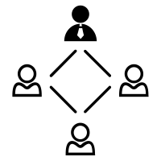
Sify as an SD-WAN partner
Network & Service Provider Agnostic Solution
Sify Owned Sify Managed Highly redundant SD-WAN Platform
NOC, SOC and systems experience
Pan India Regional Field team Structure
Support for 3rd party ISP links
End-to-End Managed Services Model- Edge CPEs, Subscription, Installation & Support
Cloud based, Multi tenant platform hosted within Sify Core Net work infrastructure
Geo-redundant core for business continuity (Mumbai and Chennai)
High level of redundancy for Connectivity links for the platform
Managed 24x7 by skilled resources
Managing multi-vendor environments, single ownership, SLA driven
Integrated NOC & SOC, 24x7x365 monitoring and management
Visibility Tools -1200+ Man Years in Tools & Process
1800+ Network services strength
Sify presence in 1500+ cities in India
1300 + trained engineers on field covering 400+ locations
Project teams that deliver customer centric projects
Notes:
Why Sify is an ideal partner for SDWAN deployments:
Sify can provide SDWAN solution irrespective of Service providers and media types and provide End-to-End Managed Services Model- Edge CPEs, Subscription, Installation & Support.
Sify has created Geo redundant headend infra for SDWAN Control components in Sify’s own core network. This infra is managed 24x7 by skilled resources ensuring high availability. This high capacity infra can support multiple tenants and is highly scalable.

Slide 20
III
NETWORK ARCHITECTURE FOR CENTRALIZED VISIBILITY & CONTROL

Slide 21
NETWORK ARCHITECTURE FOR centralized Visibility & control
To make most of their Cloud investment, organizations need:
Enterprises can leverage centralized network management for
Comprehensive and in-depth visibility
Complete control over network connectivity
Highest level of visibility
Complete control over network resources
Effortless orchestration and automation
Intelligent insights for data driven decision-making

Slide 22
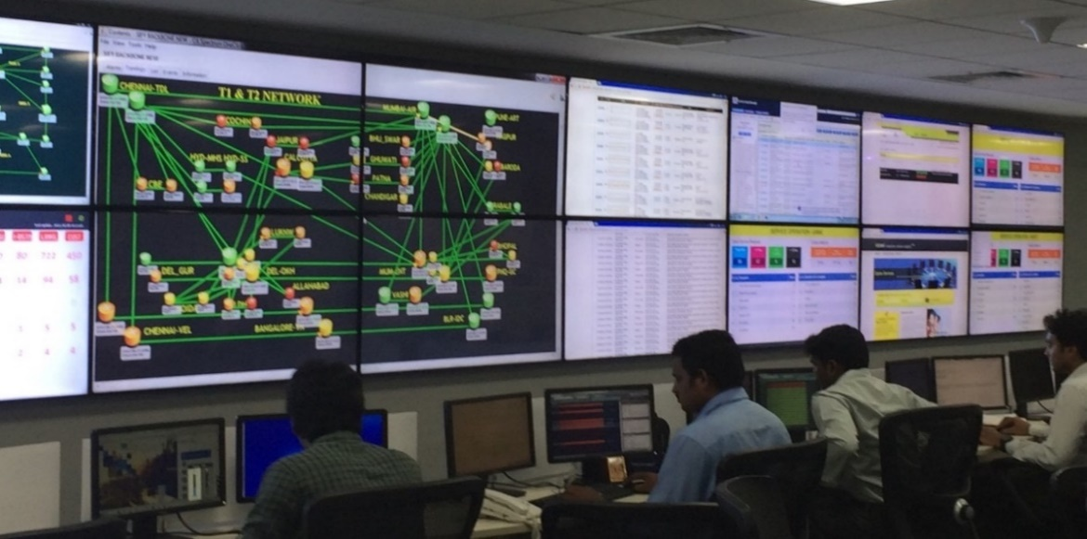
SINGLE PANE OF GLASS for network orchestration & ANALYTICS
Network Traffic trends and anomalies.
Analyze and uncover deeper insights to make adjustments or fix problems.
Management beyond WAN to provide a single unified view of LAN, WAN, DC, Network Security and SDWAN technologies.
Service desk
Managed LAN
Fault Management
Managed WAN
Performance Management
Shared NOC
SLA Management
Captive NOC
Capacity Management
Managed Infrastructure
Network Security
Managed Security
Regulatory Management
NW INTEGRATION
Change Management
PROJECT DELIVERY
VOICE
TELECOM
ENTERPRISE
SECURITY
FACILITY
POPs

Slide 23
SIFY’s Variants of Network Management and Operations
Network Operations Outsourcing
Network Consolidation & Operations Outsourcing
Network Transformation & Operations
Operations Transition from existing managed services provider to Sify
Advanced NOC Services
SLA Management
Vendor Management
AMC Management
Network study & assessment
Service provider consolidation (Including Sify participation)
Performance Management and optimization
CPE Management
Network redesign/ reengineering
Software defined network deployment
Notes:
There could be three approaches in which Sify can offer NOC Services to customers:
NOC Operations Outsourcing: Sify will transition the as-is WAN network under Sify Management and provide 24x7 monitoring of links, incident management, change management, unified SLA management across multiple service providers and AMC management for HW contracts.
Network Consolidation & Operations Outsourcing: Along with NOC Operations Outsourcing KPIs, Sify will help in network study, assessment & consolidation of WAN networks. Sify will provide own connectivity wherever required to build desired redundancies. CPEs are also managed 24x7 by Sify GNOC team.
Network Transformation & Operations: In this approach Sify undertakes redesigning and reengineering as-is WAN network to a new highly reliable network architecture which is optimized and scalable to customer business needs. This new WAN can be based on SDWAN architecture to given more visibility in the network and give features of dynamic traffic steering based on link performances.

Slide 24
SIFy NOC Services
What are
Sify NOC Services
How are
these offered?
What is in it
for customers?
24x7 proactive monitoring & management of WAN network
Management & Monitoring of Customer Premise Equipment (CPE)
Offers ‘end to end’ network availability, performance and reporting
SLA driven services with industry best standards
Offered from SIFY’s state of the art Managed Services Network Operations Center (MS-NOC)
MS-NOC acts as a Single point of ownership for all Sify associated services
For third party vendors, MS-NOC can extend support for vendor coordination on case-to-case basis
Customer is also provided a web-based tool for viewing & reports
Comprehensive visibility to minute details WAN infra
Minimal & Critical footprint On-Premises
Available in multiple variants to for diverse WAN deployments
Lower TCO
Industry best tools & resources support

Slide 25
SIFY SUCCESS STORIES

Slide 26
Win theme:
Network Transformation

Slide 27
Unlocked cloud potential with Sify’s cloud ready Network
Transformation Goal: Ensure centralized connectivity for cloud applications and geographically spread branches.
Objective
Why Sify was chosen?
Sify’s value additions
A network for agility and flexibility for cloud applications
Centralized connectivity and management for geographically spread locations
Network cost optimization
Sify is a leader in Cloud Enabling technologies and has delivered largest MPLS network for India Post in PSU sector.
Sify is capable of end-to-end provisioning, installation, configuration & management of SD-WAN devices at all locations
Sify has built and managed a Centralized Billing Solution, hosted on Cloud and offered on a flexible outcome-based model which delivered huge cost saving over 5 years
Complete WAN back-up based on SD-WAN with layer 3 MPLS for 750 locations
SD-WAN MPLS links at each location, management of aggregate bandwidth on SD-WAN devices
Management of Other Service Provider links, with SLA management
Mesh Network topology for IP Telephony and video conference.
NMS tool, online portal access to monitor links performance and advanced reporting.
27

Slide 28
Centralized SD WAN over MPLS Connecting 750 Locations, DC & DR to Reduce Operating costs
Before transformation
After transformation
Customer success
Dual MPLS connections to the cloud had varying bandwidth
All links and routers provided and managed by multiple Service Providers
Online systems required continuous efforts for robustness & efficiency.
Performance on MPLS network was slow for moving applications to cloud
Systems unable to support different topologies - any-to-any, hub-spoke & partial mesh etc.
Centralized authentication system to authenticate network elements of control plane, data plane and NMS management tool.
Traffic dynamically routed based on application, endpoint, and network conditions to deliver best performance on cloud.
Scalable solution to meet future requirements as and when required
SD WAN over MPLS Network provides centralized, policy driven, dashboard -based monitoring/control and supports Zero Touch Provisioning with automated outage detection & correction
Improved business-critical application performance, capacity management and planning resulting in reduced network operating costs.
Achieved centralized policy enforcement across all locations, dashboard-based monitoring and control of the entire WAN.
Single ownership with Sify for installation, configuration and 24x7 monitoring & management.

Slide 29
More Case Studies to be Added

Slide 30
Key Takeaways
Emerging business & technology trends have compelled enterprises to empower their network with inherent intelligence
To enable intelligence, fundamental network transformation & re-architecting is needed for:
Evolving DC and Cloud landscape
Distributed/mission critical applications
Network orchestration needs
Transform your network into a robust and intelligent asset with Sify’s:
Cloud-Ready Networks
Software-Defined WAN
Centralized Network Managed Services
Compelling benefits of Sify’s Intelligent Network Services:
Optimize multi-cloud connectivity
Modernize and develop new processes, services, and models
Make data-driven decisions for cost control and security
Deliver top-tier experience to customers

Slide 31
Key Takeaways
Emerging business & technology trends have compelled enterprises to empower their network with inherent intelligence
To enable intelligence, fundamental network transformation & re-architecting is needed for:
Evolving DC and Cloud landscape
Distributed/mission critical applications
Network orchestration needs
Transform your network into a robust and intelligent asset with Sify’s:
Cloud-Ready Networks
Software-Defined WAN
Centralized Network Managed Services
Compelling benefits of Sify’s Intelligent Network Services:
Optimize multi-cloud connectivity
Modernize and develop new processes, services, and models
Make data-driven decisions for cost control and security
Deliver top-tier experience to customers

Slide 32
Key Takeaways
Emerging business & technology trends have compelled enterprises to empower their network with inherent intelligence
To enable intelligence, fundamental network transformation & re-architecting is needed for:
Transform your network into a robust and intelligent asset with Sify’s:
Compelling benefits of Sify’s Intelligent Network Services:
Evolving DC and Cloud landscape
Distributed/mission critical applications
Network orchestration needs
Cloud-Ready Networks
Software-Defined WAN
Centralized Network Managed Services
Optimize multi-cloud connectivity
Modernize and develop new processes, services, and models
Make data-driven decisions for cost control and security
Deliver top-tier experience to customers

Slide 33
Key Takeaways
Compelling benefits of Sify’s Intelligent Network Services:
Transform your network into a robust and intelligent asset with Sify’s:
Optimize multi-cloud connectivity
Modernize and develop new processes, services, and models
Make data-driven decisions for cost control and security
Deliver top-tier experience to customers
To enable intelligence, fundamental network transformation & re-architecting is needed for:
Cloud-Ready Networks
Software-Defined WAN
Centralized Network Managed Services
Emerging business & technology trends have compelled enterprises to empower their network with inherent intelligence
Evolving DC and Cloud landscape
Distributed/mission critical applications
Network orchestration needs

